Slide 1
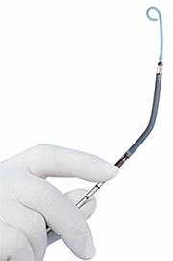
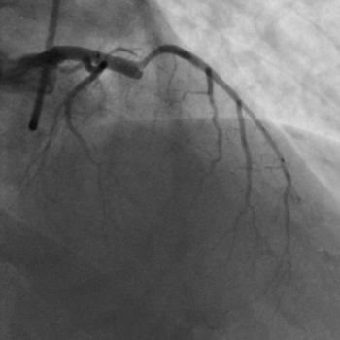
Improving Outcomes in Cardiogenic Shock
Yuri B. Pride, MD, FACC, FSCAI
7th Annual Synergy Cardiac/EP Summit
July 8, 2017

Slide 2
Disclosures
No relevant disclosures
Consultant
2009-present, Boston Clinical Research Institute
Eli Lilly
Roche
Novo Nordisk
Astellas
Pfizer
Microport
Gilead
Legal malpractice consulting

Slide 3
Outline
Definition of cardiogenic shock
Demographics of cardiogenic shock
Acute MI
Early angiography and intervention
Percutaneous left ventricular assist devices
Intraortic balloon pump
Impella

Slide 4
Cardiogenic Shock
Definition
Persistent hypotension (SBP <90 mmHg or MAP 30 mmHg less than baseline)
Severe reduction in cardiac output/index
Adequate or elevated filling pressures
Most common cause is acute MI
Other causes include myocarditis, Takotsubo CMPY, acute MR or AR, massive PE
Circulation 2008. 117:686

Slide 5
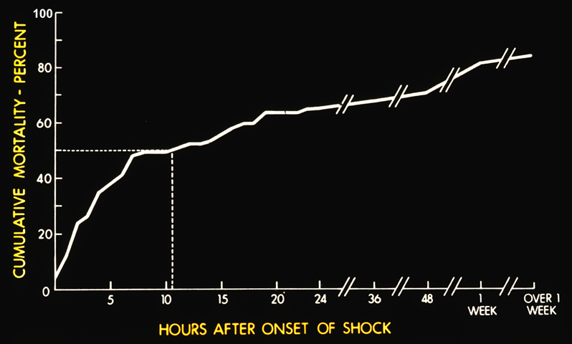
Cardiogenic Shock is Bad

Slide 6
Cardiogenic Shock
Occurs in 5-8% of STEMI patients and ~2.5% of NSTEMI patients
Approximately 40-50,000 cases per year
Risk factors
Age, anterior MI, HTN, diabetes mellitus, multivessel CAD, prior MI, prior CHF, STEMI and LBBB
Circulation 2008. 117:686

Slide 7
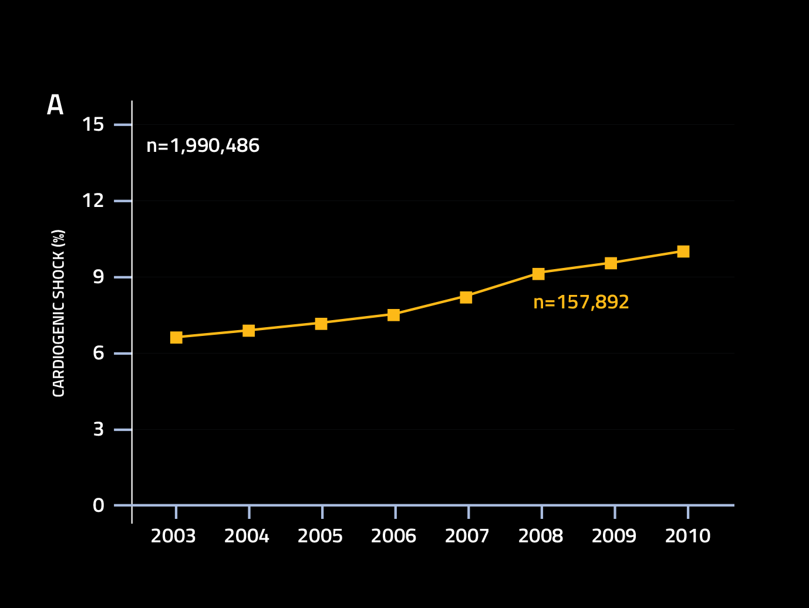
Incidence is Rising
Circulation 2008. 117:686

Slide 8
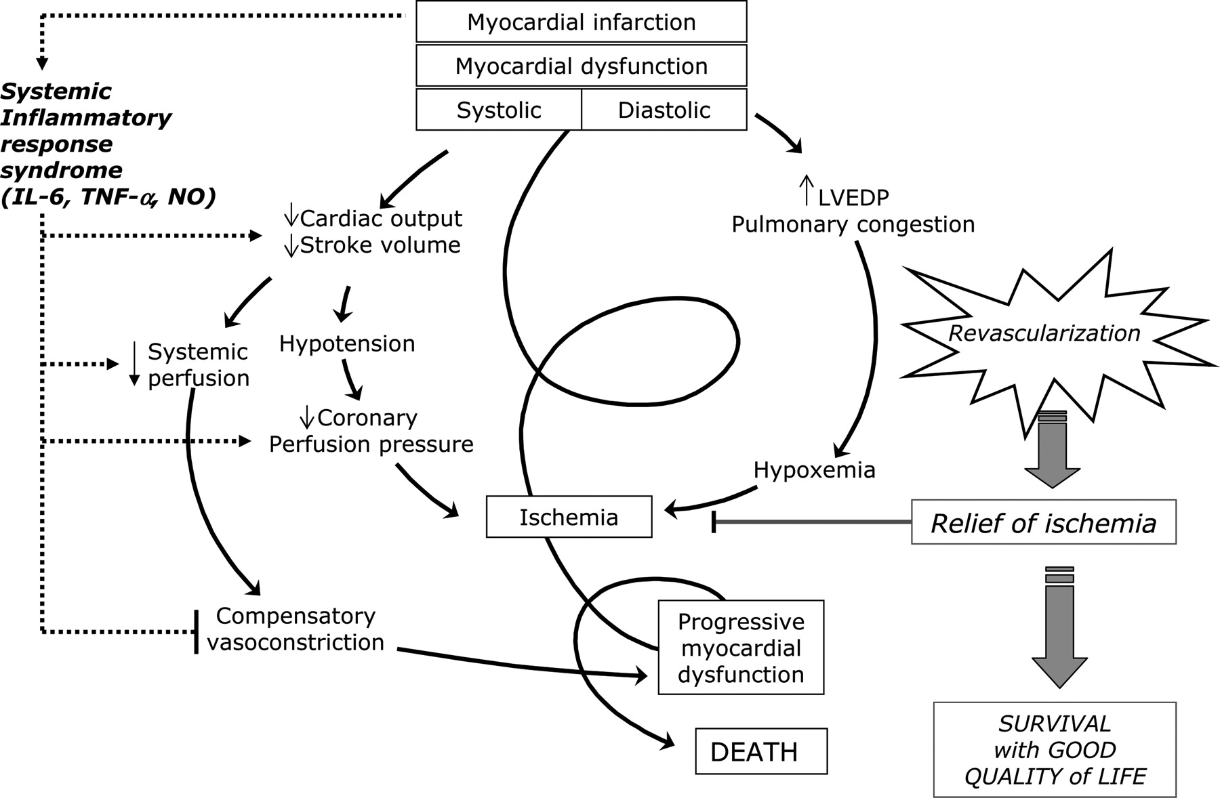
Circulation 2008. 117:686

Slide 9
Revascularization
JAMA 2006. 295:2511

Slide 10
Still work to do
Inpatient mortality still hovers around 50%
Use of vasopressors associated with higher mortality
J Card Surg 2009. 14:288

Slide 11
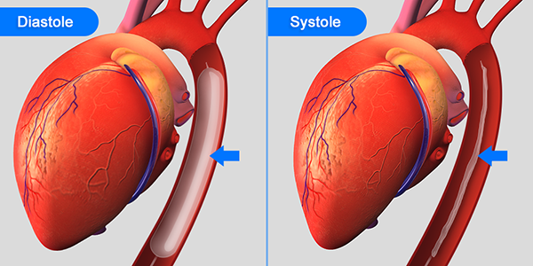
Balloon pump

Slide 12
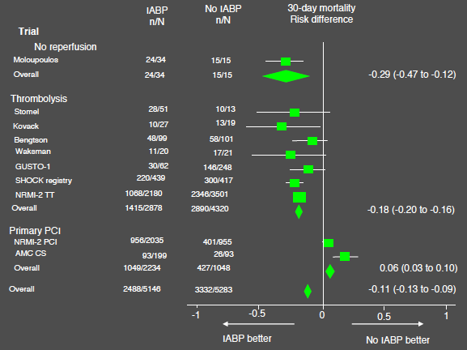
Eur Heart J 2009. 30:459

Slide 13
IABP SHOCK II Trial
Randomized 600 patients with acute MI complicated by cardiogenic shock
SBP < 90mmHg or use of vasopressors
Clinical signs of pulmonary congestion
Impaired end-organ perfusion
Altered mental status, cold and clammy skin, oliguria and/or lactate >2.0 mmol/L
N Engl J Med 2012. 367:1287

Slide 14
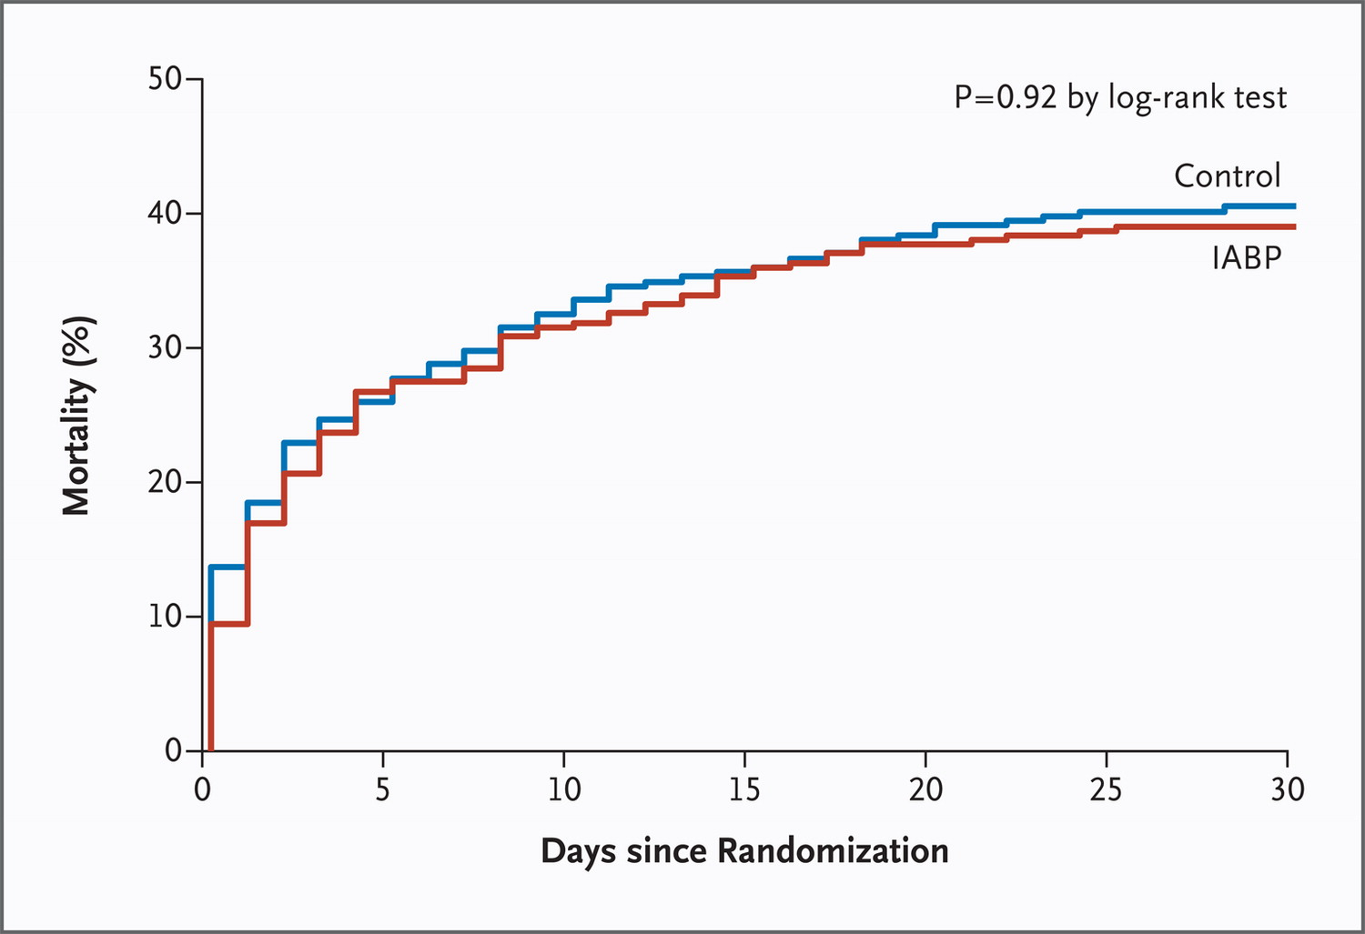
IABP SHOCK II Trial
N Engl J Med 2012. 367:1287

Slide 15
Impella pVAD

Slide 16
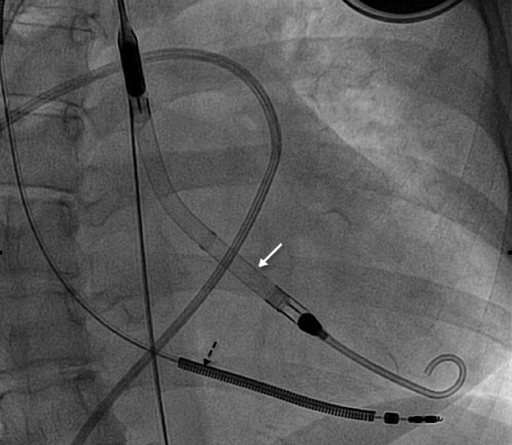

Slide 17
Outflow
(aortic root)
Inflow
(ventricle)
aortic
valve
Cardiac Power Output
(MAP x Cardiac Output x 0.0022)
Flow
MAP
LVEDP and LVEDV
(n=189)
Wall
Tension
Mechanical
Work
Microvascular
Resistance
Est. In-Hospital Mortality
Coronary Perfusion
Cardiac Power Output
O₂ Supply
O₂ Demand
Cardiac Power Output (Watts)
End Organ Perfusion
Unloading to Myocardial Recovery
Fincke, et. al. JACC, 2009 SHOCK TRIAL

Slide 18
How much support?
(L/min/m²)
Impella 2.5
N=26
IABP
2.20±0.64
P= 0.02
1.84±0.71
1.71±0.45
1.73±0.59
N.S.
Augmented CI
Ventricular Unloading
Impella 2.5
Native
Heart
Native CI
Pre-Support
On Impella
Pre-Support
On
IABP
J Am Coll Cardiol 2008. 52:1584

Slide 19
cVAD Registry
Mortality Based on the Number of Inotropes Used Before Impella Support

Slide 20
cVAD Registry
Mortality Based on Duration of Cardiogenic Shock Before Impella Support

Slide 21
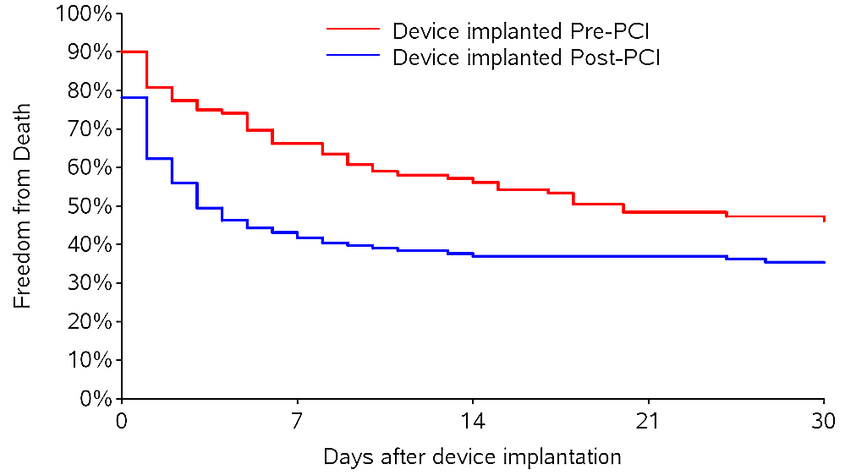
AMICS Registry

Slide 22
IMPRESS Study
Enrolled 48 patients
Acute MI complicated by cardiogenic shock
SBP <90 mmHg for >30 mins or vasopressors required to maintain SBP >90 mmHg
Respiratory failure requiring mechanical ventilation
Primary outcome was all-cause mortality

Slide 23
Primary outcome

Slide 24
Limitations
Small study
Nearly all support devices were placed following PCI rather than pre-PCI
92% of patients had cardiac arrest
48% of these had ROSC >20 mins
Growing body of evidence to improve “door-to-unloading” in cardiogenic shock

Slide 25
Conclusions
Cardiogenic shock continues to be associated with high mortality
Early revascularization is critical
IABP did not lead to improved survival
IIb recommendation in ESC guidelines
Impella shows promise, but no definitive evidence of clinical benefit
IIb recommendation in ESC guidelines

