Slide 1
Sreeni Gangasani MD, FACC.
Heart failure 2017
Focused update

Slide 2
What is Congestive Heart Failure or CHF?
A complex clinical syndrome in which the heart is incapable of maintaining a cardiac output adequate to accommodate metabolic requirements and the venous return.

Slide 3
Prevalence of HF by Age and Gender
United States: 1988-94

Slide 4
How Many Americans Suffer From Heart Failure
2.5M
5.5M
7.5M
10M
1
102 / 150
Cross-tab label

Slide 5









HEART FAILURE BURDEN IN THE UNITED STATES
Heart failure is a growing and expensive public health issue
2.8M
5.1M
AMERICANS SUFFER FROM HEART FAILURE³
OFFICE AND ED VISITS EACH YEAR⁵
1.0M
> 650K
HEART FAILURE HOSPITALIZATIONS EACH YEAR⁶
NEW HEART FAILURE DIAGNOSES EACH YEAR^{1,2}
HEART FAILURE IS THE LEADING CAUSE OF HOSPITALIZATIONS
AMONG > 65-YEAR-OLD PATIENTS⁷
1 in 2
EVERY 30 SECONDS,
SOMEONE IS HOSPITALIZED
FOR HEART FAILURE⁸
5 YRS
HEART FAILURE PATIENTS
DIE IN 5 YEARS⁴

Slide 6




ECONOMIC BURDEN OF HF ADMISSIONS IN THE U.S.
TOTAL COST OF HEART FAILURE IN THE U.S. EXPECTED TO DOUBLE BY 2030⁹
$
> 1/2
OF COSTS SPENT ON HOSPITALIZATIONS²
$70B
$31B
1/5th
OF ALL MEDICARE ADMISSIONS IN THE U.S. HAVE A DIAGNOSIS OF HEART FAILURE¹³
2013
2030
HIGH READMISSION RATES
25%
50%
READMISSION WITHIN 30 DAYS²
READMISSION WITHIN 6 MONTHS¹²
5.1 days
MOST HEART FAILURE PATIENTS SUFFER RE-CONGESTION WITHIN 60 DAYS – EVEN AT THE BEST HOSPITALS¹¹
AVERAGE HOSPITAL LENGTH OF STAY¹⁰

Slide 7
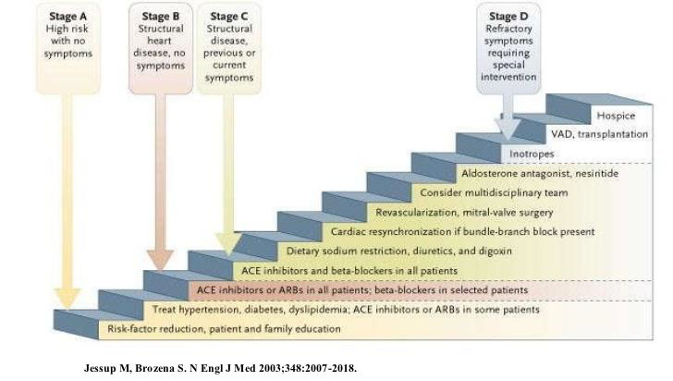
Heart Failure Stages by ACC/AHA

Slide 8
Treatment Approach for the Patient with Heart Failure
Stage A
At high risk, no structural disease
Stage B
Structural heart disease, asymptomatic
Stage C
Structural heart disease with prior/current symptoms of HF
Stage D
Refractory HF requiring specialized interventions
Therapy
Treat Hypertension
Treat lipid disorders
Encourage regular exercise
Discourage alcohol intake
ACE inhibition
Therapy
All measures under stage A
ACE inhibitors in appropriate patients
Beta-blockers in appropriate patients
Therapy
All measures under stage A
Drugs:
Diuretics
ACE inhibitors
Beta-blockers
Digitalis
Dietary salt restriction
Therapy
All measures under stages A,B, and C
Mechanical assist devices
Heart transplantation
Continuous (not intermittent) IV inotropic infusions for palliation
Hospice care
Hunt, SA, et al ACC/AHA Guidelines for the Evaluation and Management of Chronic Heart Failure in the Adult, 2001
Notes:
Stages (as classified in ACC/AHA guidelines) in the evolution of heart failure and recommended therapy
Hunt, SA, Baker, DW, Chin, MH, Cinquegrani MP, Feldman AM, Francis GS, Ganiats TG, Goldstein S, Gregoratos G, Jessup ML, Noble RJ, Packer M, Silver MA, Stevenson LW. ACC/AHA guidelines for the evaluation and management of chronic heart failure in the adult: a report of the American College of Cardiology/American Heart Association Task Force on Practice Guidelines, 2001.

Slide 9
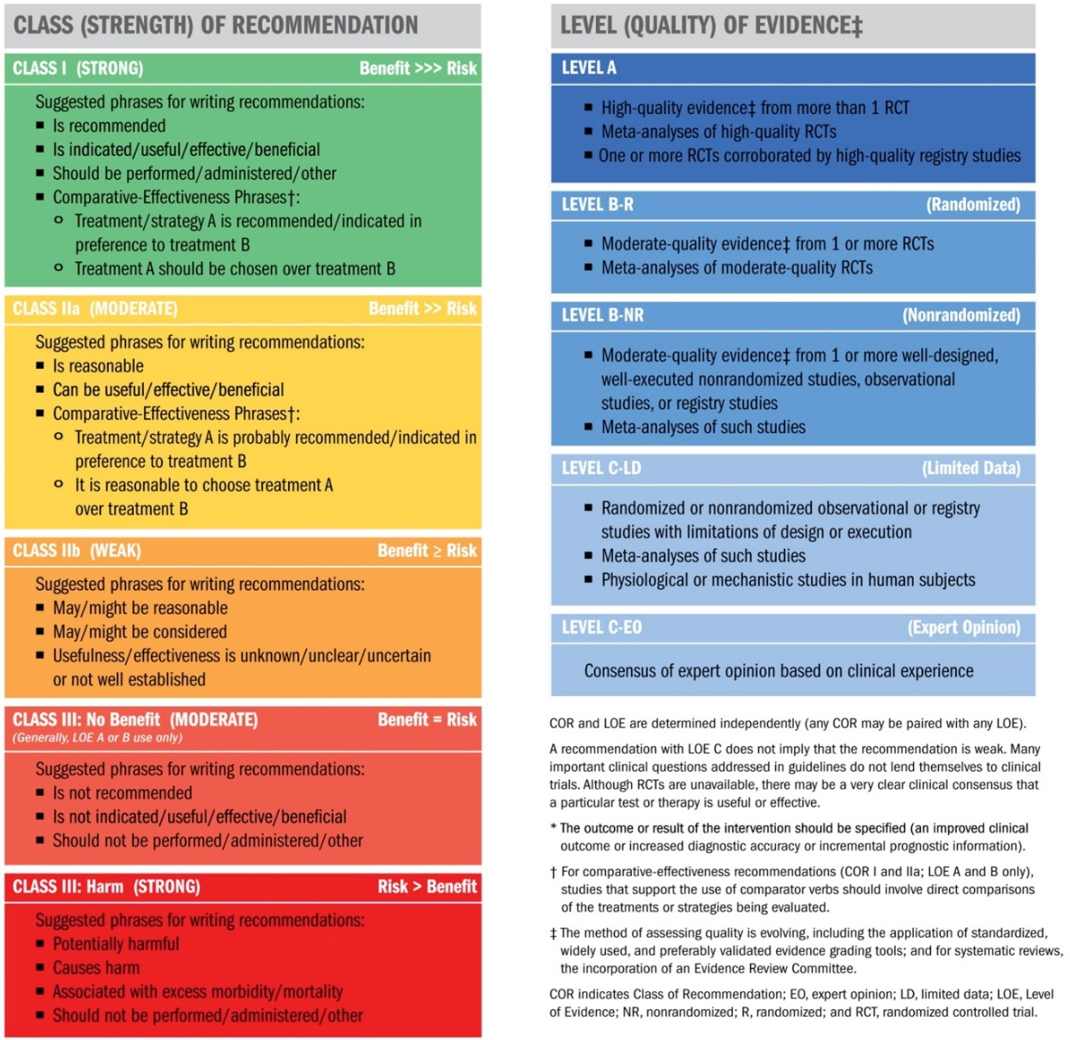
Classification of Recommendations and Levels of Evidence

Slide 10
2017 ACC/AHA/HFSA Focused Update of the 2013 ACCF/AHA Guideline for the Management of Heart Failure
Developed in Collaboration With the American Academy of Family Physicians, American College of Chest Physicians, and International Society for Heart and Lung Transplantation

Slide 11
Citation
ACC/AHA/HFSA Focused Update of the 2013 ACCF/AHA Guideline for the Management of Heart Failure (Journal of the American College of Cardiology). Published on April 28, 2017, available at: Yancy, et. al. ACC/AHA/HFSA 2017 Heart Failure Focused Update
The full-text guidelines are also available on the following Web sites:
American College of Cardiology (www.acc.org)
American Heart Association (professional.heart.org)
Heart Failure Society of America(www.hfsa.org)

Slide 12
Introduction
The purpose is to update the 2013 HF guideline in areas where in which new evidence has emerged since its publication.
The scope of the focused update includes revision to the sections on
New therapies indicated for stage C HF with reduced ejection fraction
  Updates on HF with preserved ejection fraction (HFpEF)
  New data on important comorbidities, including sleep apnea, anemia, and hypertension
  And new insights regarding the prevention of HF

Slide 13
Pharmacologic Treatment for Stage C HFrEF
Notes:
380624 slide 37

Slide 14
Question
Cumulative risk reduction if all the evidence based therapies are used
A) 20%
B) 40%
C) 60%
D) 80%

Slide 15
Cumulative Risk Reduction if All the Evidence Based Therapies are Used
20%
40%
60%
80%
0
0 / 150
Cross-tab label

Slide 16
Drugs That Reduce Mortality in Heart Failure With Reduced Ejection Fraction
Angiotensin
receptor
blocker
Mineralocorticoid
receptor
antagonist
ACE
inhibitor
Beta
blocker
0%
10%
20%
% Decrease in Mortality
Drugs that inhibit the renin-angiotensin system have modest effects on survival
30%
40%
Based on results of SOLVD-Treatment, CHARM-Alternative,
COPERNICUS, MERIT-HF, CIBIS II, RALES and EMPHASIS-HF

Slide 17
Mortality reduction with CHF Rx
Cumulative risk reduction if all evidence-based therapies are used: 80%
Absolute risk reduction: 28.1%
Relative-risk reduction 2 yr Mortality
None 35%
ACEI or ARB 23% 27%
Beta Blocker 35% 18%
Aldosterone Ant 30% 13%
CRT-D (EF<35, QRS>120) 36% 8.3%
ARNI 16% 6.9%

Slide 18
Question
65 yr old Caucasian male with ischemic CM with EF of 25% comes in to office for follow up after recent HF admit. C/o mild exertional dyspnea but able to do his regular activities with slight limitation. No change in weight recently
Meds: Lisinopril 40 mg po qd, Coreg 25 mg po bid, Aldactone 25 mg po q d, Lasix 40 mg po qd , Digoxin 0.125 mg po qd, Asa 81 mg po qd
BP 128/80, HR 64 bpm, sat 96% on RA, No JVD, Lungs: clear
Heart: RRR, normal s1 and s2, II/VI SM, No edema
Labs: Na 135, K 4.0, Cr 1.2, Hb 12.5, BNP 260

Slide 19
Your recommendation is:
No change in therapy
Increase Lasix to 60 mg po qd
Change Lisinopril to Sacubitril/Valsartan (Entresto)
Add Ivabradine (Corlanor)
0
92 / 150
Cross-tab label

Slide 20
PARADIGM-HF: Summary of Findings
In heart failure with reduced ejection fraction, when
compared with recommended doses of enalapril:
LCZ696 was more effective than enalapril in . . .
• Reducing the risk of CV death and HF hospitalization
• Reducing the risk of CV death by incremental 20%
• Reducing the risk of HF hospitalization by incremental 21%
• Reducing all-cause mortality by incremental 16%
• Incrementally improving symptoms and physical limitations
LCZ696 was better tolerated than enalapril . . .
• Less likely to cause cough, hyperkalemia or renal impairment
• Less likely to be discontinued due to an adverse event
• More hypotension, but no increase in discontinuations
• Not more likely to cause serious angioedema

Slide 21
Renin-Angiotensin System Inhibition With ACE-Inhibitor or ARB or ARNI
Pharmacological Treatment for Stage C HF With Reduced EF
COR | LOE | Recommendations | Comment/ Rationale
I | ACE-I: A | The clinical strategy of inhibition of the renin-angiotensin system with ACE inhibitors (Level of Evidence: A), OR ARBs (Level of Evidence: A), OR ARNI (Level of Evidence: B-R) in conjunction with evidence-based beta blockers, and aldosterone antagonists in selected patients, is recommended for patients with chronic HFrEF to reduce morbidity and mortality. | NEW: New clinical trial data prompted clarification and important updates.
 | ARB: A
 | ARNI: B-R

Slide 22
Renin-Angiotensin System Inhibition With ACE-Inhibitor or ARB or ARNI
Pharmacological Treatment for Stage C HF With Reduced EF
COR | LOE | Recommendations | Comment/ Rationale
I | ACE-I: A | The use of ACE inhibitors is beneficial for patients with prior or current symptoms of chronic HFrEF to reduce morbidity and mortality. | 2013 recommendation repeated for clarity in this section.
I | ARB: A | The use of ARBs to reduce morbidity and mortality is recommended in patients with prior or current symptoms of chronic HFrEF who are intolerant to ACE inhibitors because of cough or angioedema. | 2013 recommendation repeated for clarity in this section.

Slide 23
Renin-Angiotensin System Inhibition With ACE-Inhibitor or ARB or ARNI
Pharmacological Treatment for Stage C HF With Reduced EF
COR | LOE | Recommendations | Comment/ Rationale
I | ARNI: B-R | In patients with chronic symptomatic HFrEF NYHA class II or III who tolerate an ACE inhibitor or ARB, replacement by an ARNI is recommended to further reduce morbidity and mortality. | NEW: New clinical trial data necessitated this recommendation.

Slide 24
Angiotensin Neprilysin Inhibition With LCZ696 Doubles Effect on Cardiovascular Death of Current Inhibitors of the Renin-Angiotensin System
Angiotensin
receptor
blocker
Angiotensin
neprilysin
inhibition
ACE
inhibitor
0%
15%
18%
10%
20%
% Decrease in Mortality
20%
30%
40%
Effect of ARB vs placebo derived from CHARM-Alternative trial
Effect of ACE inhibitor vs placebo derived from SOLVD-Treatment trial
Effect of LCZ696 vs ACE inhibitor derived from PARADIGM-HF trial

Slide 25
Renin-Angiotensin System Inhibition With ACE-Inhibitor or ARB or ARNI
Pharmacological Treatment for Stage C HF With Reduced EF
COR | LOE | Recommendations | Comment/ Rationale
III: Harm | B-R | ARNI should not be administered concomitantly with ACE inhibitors or within 36 hours of the last dose of an ACE inhibitor. | NEW: Available evidence demonstrates a potential signal of harm for a concomitant use of ACE inhibitors and ARNI.
III: Harm | C-EO | ARNI should not be administered to patients with a history of angioedema. | NEW: New clinical trial data.

Slide 26
Ivabradine
Pharmacological Treatment for Stage C HF With Reduced EF
COR | LOE | Recommendations | Comment/ Rationale
IIa | B-R | Ivabradine can be beneficial to reduce HF hospitalization for patients with symptomatic (NYHA class II-III) stable chronic HFrEF (LVEF ≤35%) who are receiving GDEM*, including a beta blocker at maximum tolerated dose, and who are in sinus rhythm with a heart rate of 70 bpm or greater at rest. | NEW: New clinical trial data.
*In other parts of the document, the term “GDMT” has been used to denote guideline-directed management and therapy. In this recommendation, however, the term “GDEM” has been used to denote this same concept in order to reflect the original wording of the recommendation that initially appeared in the “2016 ACC/AHA/HFSA Focused Update on New Pharmacological Therapy for Heart Failure: An Update of the 2013 ACCF/AHA Guideline for the Management of Heart Failure”.

Slide 27
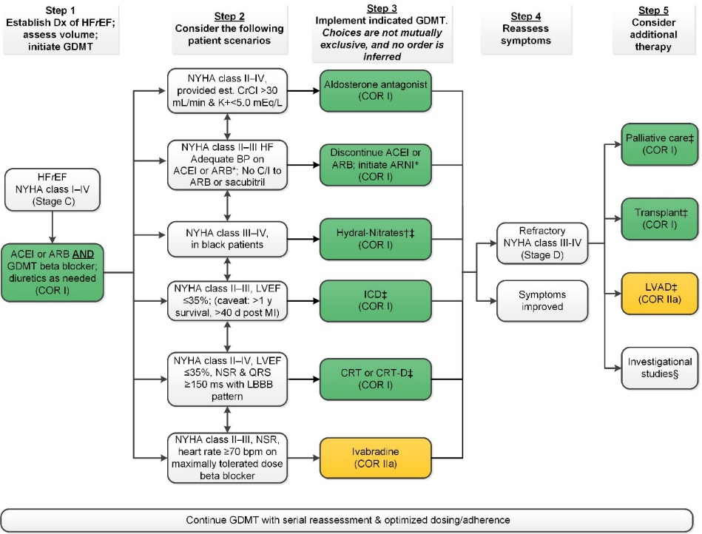
Treatment of HFrEF Stage C and D

Slide 28
Clinical Events and Findings Useful for Identifying Patients With Advanced HF
Repeated (≥2) hospitalizations or ED visits for HF in the past year
Progressive deterioration in renal function (e.g., rise in BUN and creatinine)
Weight loss without other cause (e.g., cardiac cachexia)
Intolerance to ACE inhibitors due to hypotension and/or worsening renal function
Intolerance to beta blockers due to worsening HF or hypotension
Frequent systolic blood pressure <90 mm Hg
Persistent dyspnea with dressing or bathing requiring rest
Inability to walk 1 block on the level ground due to dyspnea or fatigue
Recent need to escalate diuretics to maintain volume status, often reaching daily furosemide equivalent dose >160 mg/d and/or use of supplemental metolazone therapy
Progressive decline in serum sodium, usually to <133 mEq/L
Frequent ICD shocks
Adapted from Russell et al. Congest Heart Fail. 2008;14:316-21.

Slide 29
Treatment of Stages A to D
Mechanical Circulatory Support

Slide 30
Mechanical Circulatory Support
I
IIa
IIb
III
MCS use is beneficial in carefully selected* patients with stage D HFrEF in whom definitive management (e.g., cardiac transplantation) or cardiac recovery is anticipated or planned.
Nondurable MCS, including the use of percutaneous and extracorporeal ventricular assist devices (VADs), is reasonable as a “bridge to recovery” or a “bridge to decision” for carefully selected* patients with HFrEF with acute, profound hemodynamic compromise.
Durable MCS is reasonable to prolong survival for carefully selected* patients with stage D HFrEF.
B
I
IIa
IIb
III
B
I
IIa
IIb
III
B

Slide 31
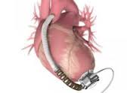

Left Ventricular Assist Device(LVAD)

Slide 32
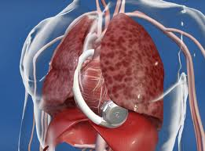
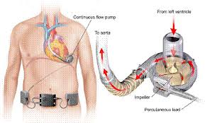

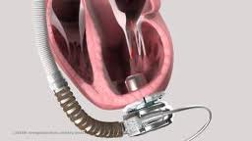
Heartware LVAD

Slide 33
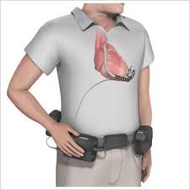
Heartware LVAD

Slide 34
Treatment of Stages A to D
Cardiac Transplantation

Slide 35
Cardiac Transplantation
I
IIa
IIb
III
Evaluation for cardiac transplantation is indicated for carefully selected patients with stage D HF despite GDMT, device, and surgical management.

Slide 36
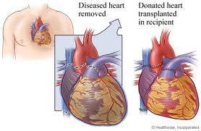
Heart Transplantation

Slide 37
Pharmacological Treatment for Stage C HF With Preserved EF
COR | LOE | Recommendations | Comment/ Rationale
IIa | C | Coronary revascularization is reasonable in patients with CAD in whom symptoms (angina) or demonstrable myocardial ischemia is judged to be having an adverse effect on symptomatic HFpEF despite GDMT. | 2013 recommendation remains current.
IIa | C | Management of AF according to published clinical practice guidelines in patients with HFpEF is reasonable to improve symptomatic HF. | 2013 recommendation remains current.
IIa | C | The use of beta-blocking agents, ACE inhibitors, and ARBs in patients with hypertension is reasonable to control blood pressure in patients with HFpEF. | 2013 recommendation remains current.

Slide 38
Pharmacological Treatment for Stage C HF With Preserved EF
COR | LOE | Recommendations | Comment/ Rationale
IIb | B-R | In appropriately selected patients with HFpEF (with EF ≥45%, elevated BNP levels or HF admission within 1 year, estimated glomerular filtration rate >30 mL/min, creatinine <2.5 mg/dL, potassium <5.0 mEq/L), aldosterone receptor antagonists might be considered to decrease hospitalizations. | NEW: Current recommendation reflects new RCT data.
IIb | B | The use of ARBs might be considered to decrease hospitalizations for patients with HFpEF. | 2013 recommendation remains current.

Slide 39
Pharmacological Treatment for Stage C HF With Preserved EF
COR | LOE | Recommendations | Comment/ Rationale
III: No Benefit | B-R | Routine use of nitrates or phosphodiesterase-5 inhibitors to increase activity or QoL in patients with HFpEF is ineffective. | NEW: Current recommendation reflects new data from RCTs.
III: No Benefit | C | Routine use of nutritional supplements is not recommended for patients with HFpEF. | 2013 recommendation remains current.

Slide 40
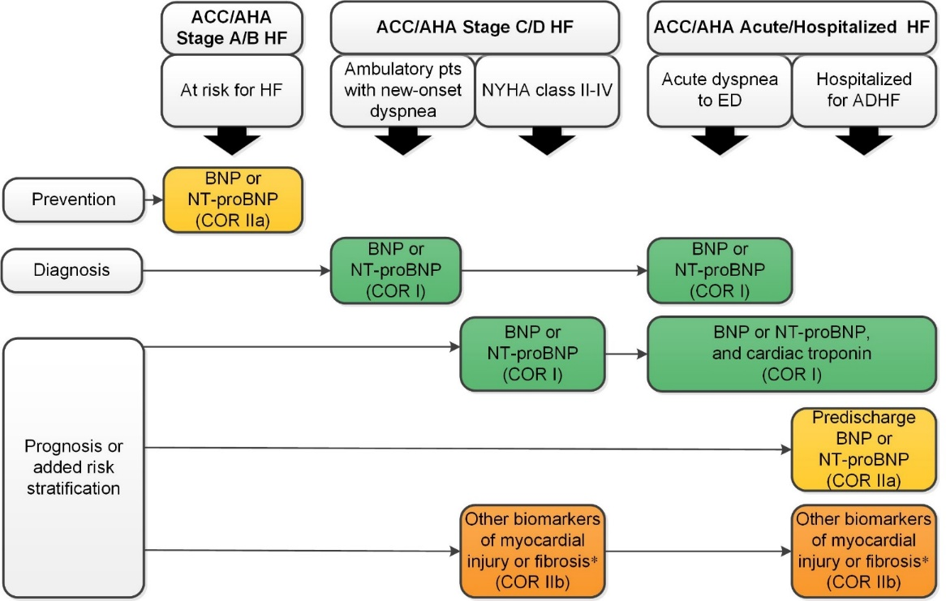
Biomarkers Indications for Use
*Other biomarkers of injury or fibrosis include soluble ST2 receptor, galectin-3, and high-sensitivity troponin.
ACC indicates American College of Cardiology; AHA, American Heart Association; ADHF, acute N-terminal pro-B-type natriuretic peptide; NYHA, New York Heart Association; and pts, patients.

Slide 41
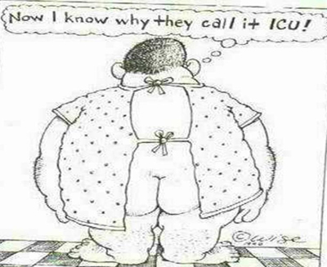

Slide 42
Prognosis or added risk stratification
Class I recommendation (Level of Evidence: A) for measurement of B-type natriuretic peptide (BNP) or N-terminal (NT)-pro-BNP for establishing prognosis or disease severity in chronic HF.
Class I recommendation (Level of Evidence: A) for measurement of baseline natriuretic peptide biomarkers and/or cardiac troponin on admission to the hospital to establish a prognosis in acutely decompensated HF.

Slide 43
Important Comorbidities in HF
Anemia

Slide 44
Anemia:
Class IIb recommendation:
For intravenous iron replacement in patients with New York Heart Association (NYHA) class II and III HF and iron deficiency (ferritin <100 ng/ml or 100-300 ng/ml if transferrin saturation <20%), to improve functional status and QoL.
Class III recommendation :
Erythropoietin stimulating agents should not be used in patients with HF and anemia to improve morbidity and mortality, as there is no benefit.

Slide 45
Important Comorbidities in HF
Sleep Disorders
(Moved from Section 7.3.1.4, Treatment of Sleep Disorders in the 2013 HF guideline)

Slide 46
Sleep-Disordered Breathing:
Class IIa recommendation:
For a formal sleep assessment in patients with NYHA class II– IV HF and suspicion of sleep-disordered breathing or excessive daytime sleepiness.
Class IIb recommendation
For utilization of continuous positive airway pressure in patients with cardiovascular disease and obstructive sleep a pnea, to improve sleep quality and daytime sleepiness.
Class III recommendation: Harm
for use of adaptive servo-ventilation in patients with NYHA class II–IV HFrEF and central sleep apnea, as it causes harm.

Slide 47
Important Comorbidities in HF
Hypertension
(New Section)

Slide 48
Treating Hypertension to Reduce the Incidence of HF
Hypertension
COR | LOE | Recommendations | Comment/ Rationale
I | B-R | In patients at increased risk, stage A HF, the optimal blood pressure in those with hypertension should be less than 130/80 mm Hg. | NEW: Recommendation reflects new RCT data.

Slide 49
Treating Hypertension in Stage C HFrEF
Hypertension
COR | LOE | Recommendations | Comment/ Rationale
I | C-EO | Patients with HFrEF and hypertension should be prescribed GDMT titrated to attain systolic blood pressure less than 130 mm Hg. | NEW: Recommendation has been adapted from recent clinical trial data but not specifically tested per se in a randomized trial of patients with HF.

Slide 50
Treating Hypertension in Stage C HFpEF
Hypertension
COR | LOE | Recommendations | Comment/ Rationale
I | C-LD | Patients with HFpEF and persistent hypertension after management of volume overload should be prescribed GDMT titrated to attain systolic blood pressure less than 130 mm Hg. | NEW: New target goal blood pressure based on updated interpretation of recent clinical trial data.

Slide 51
Hospital stay for HF
Hospitalization is a marker of poor prognosis.
Goals of RX
  Reducing symptoms and mortality
  Improving quality of life
  Decrease the risk of rehospitalization

Slide 52
Hospital stay for HF
Observed One year mortality in Medicare pts admitted with HF at one year was 37%( among 2.5 Million beneficiaries) (Data from 2001-2005)
High risk pts
Renal insufficiency
Diabetes
COPD
NYHA class III or more symptoms
Frequent hospitalizations for any cause
Hx of depression or cognitive impairment
Inadequate social support or non compliance
Multiple comorbidities

Slide 53
Readmissions
25% readmissions within 1 month
30% in 60-90 days
50% in 6 months
Who/what is responsible for these

Slide 54


Slide 55
Readmissions
Inadequate diuresis during hospital stay and noncompliance are the most common causes
How to reduce the readmissions?

Slide 56


Slide 57
Readmission prevention
Things to address to avoid readmissions
  Address exacerbating factors( ischemia, AF)
  Near optimal volume status
  Transition from IV to Oral diuretic( stable for 24 hrs)
  Patient and family education
  Near optimal pharmacologic therapy
  Plan for post dc management( scale at home, Visiting RN or phone call within 3 days after dc). Multidisciplinary team based care.
  Follow up clinic visit scheduled within 7-10 days

Slide 58
Summary
Heart failure is a chronic, progressive disease that is generally not curable, but treatable
Most recent guidelines promote lifestyle modifications and medical management with ACEI/ARB/ARNI, Beta blockers, Aldactone, digoxin, and diuretics
It is estimated 15% of all heart failure patients may be candidates for cardiac resynchronization therapy
Close follow-up of the heart failure patient is essential, with necessary adjustments in medical management
Mechanical support with LVADs is becoming more common as destination therapy.
Cardiac Transplantation is the last option for class IV pts

Slide 59
Conclusion
Use BNP for risk stratification and prognosis assessment in all stages of HF
Treat co morbidities in HF like Sleep apnea, Anemia, HTN and Ischemia.
Avoid use of Metoprolol tartrate/ Atenolol in pts with low EF( Use Metoprolol succinate or Coreg)
Consider LVAD/Transplant for stage IV advanced HF for younger patients
Consider Palliative care for advanced HF pts with more than 3 hospitalizations in 1 year who are not candidates for LVAD/TXP

Slide 60

Thank you

