Slide 1
Updates in Internal Medicine
Marty Austin, MD SFHM

Slide 2

“The art of medicine consists of amusing the patient while nature cures the disease.”
― Voltaire

Slide 3

Declarations
I have no conflicts of interest or financial ties to declare
I wish that I did. I have 3 lovely, but expensive daughters.
I am a hospitalist, not an expert on outpatient medicine.
I will try to make this fun

Slide 4
Question 1
You have a 45 year old patient who is being treated for metastatic melanoma with pembrolizumab, a “checkpoint inhibitor”. Which of the following is not a toxicity of checkpoint inhibitors?
Skin Rash
Constipation
Pneumonitis
Hepatitis
Hypothyroidism
0 / 0
Cross-tab label
20

Slide 5
Checkpoint Inhibitors
Monoclonal antibodies that bind to the “programmed cell death 1 receptor” (PD-1) on activated T cells
Prevents binding of T cell PD – 1 to it’s ligand on tumor cells, preventing downregulation of cellular immunity
More effective that chemo in PFS (22% vs. 1% at 24 months) and survival (38% vs. 30%)
Also used in nonsmall cell lung cancers

Slide 6
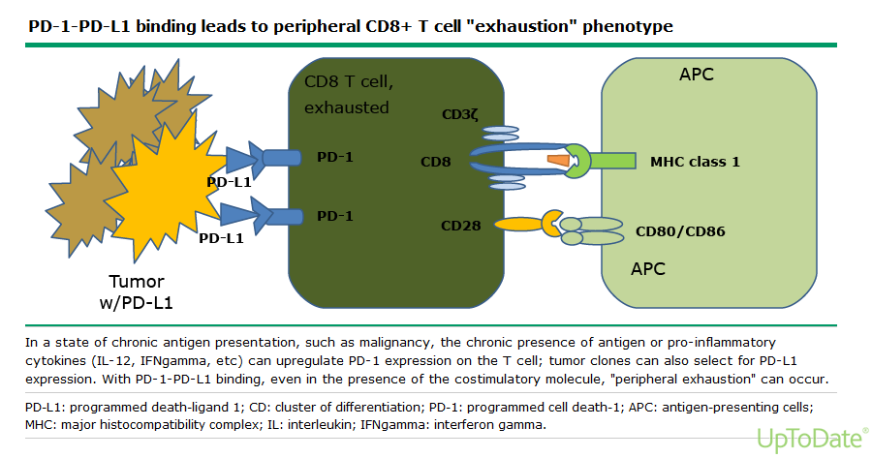

Slide 7
Question 2
In a recent study of asymptomatic, non-pregnant, adult patients presenting to the office with SBP > 180 or DBP >110:
Cardiac events were high, but lowered if patients were referred to the ED
Cardiac Events were low at 7 days in both groups, but high at 6 months in patients referred to the ER
Patients sent to the ER had higher hospital admission rates at 7 days.
Patients sent home had better blood pressure control at 7 days
20
0 / 0
Cross-tab label

Slide 8
Characteristics and Outcomes of Patients Presenting With Hypertensive Urgency in the Office Setting
Patients seen in Cleveland Clinic Hospital System January 1, 2009 to December 31, 2013
Neither group had many MACE at 7 days (0/852 sent home, 2/426 sent to ED) or 6 months (0.9% for either group)
Patients sent to ED had higher rate of admissions (4.7% v 8.2% at 7 days) and higher rates of testing.
ED patients had less uncontrolled hypertension at 1 month, but no different at 6 months.
JAMA Intern Med. 2016; 176(7): 981-988

Slide 9
Question 3
Your patient is a 60 year old female with breast cancer who is scheduled for chemotherapy. She is very concerned about losing her hair as her son’s wedding is approaching.
Which of the following has shown efficacy in preventing chemotherapy induced alopecia?
Topical Minoxidil
Scalp hypothermia
Laser therapy
Vitamin E
0 / 0
Cross-tab label
20

Slide 10
Scalp Hypothermia
Scalp hypothermia using a cooling cap has been shown to increase the proportion of patients with breast cancer who lost less than 50% of their hair from 0% to 50 – 65%.
1. Less evidence with other solid tumors, but probably effective
2. Less effective with anthracycline containing regimens
3. Cost is $1500 - $3000 per patient
4. Other methods have little to no efficacy in trials

Slide 11


Slide 12
Before You Were Born
The 1960’s, early 1970’s TV sitcom “Hogan’s Heroes” was about the madcap adventures of:
A group of Incompetent Superheroes
Workers at a diner
A man who could speak to inanimate objects
Prisoners in a Nazi POW camp during WWII.
0 / 0
Cross-tab label
20

Slide 13

Before You Were Born

Slide 14
Question 4
Mr. X is a 55 year old male patient with a history of congestive heart failure, Stage II CKD (GFR 50) and diabetes mellitus type II. He currently feels well.
Which of the following are potential benefits of using metformin for this patient?
Lower mortality rate
Decreased risk of heart attack
Lower risk of cancer
Lower weight
Less heart failure readmissions
All of the above
20
0 / 0
Cross-tab label

Slide 15
Question 5
Mrs. Y is a 50 year old woman who is seen in your office with LLQ tenderness. A CT scan confirms acute sigmoid diverticulitis without perforation or abscess formation. She has a fever of 101, but is otherwise nontoxic appearing. She is keeping down liquids. WBC is 13, other labs are normal.
Which of the following have been shown to be effective therapies for this patient:
A diet avoiding nuts and seeds
NG tube placement and suction
Intravenous antibiotics
Oral antibiotics
All of the above
None of the above
20
0 / 0
Cross-tab label

Slide 16
Br J Surg. 2017 Jan;104(1):52-61. doi: 10.1002/bjs.10309. Epub 2016 Sep 30.
Randomized clinical trial of observational versus antibiotic treatment for a first episode of CT-proven uncomplicated acute diverticulitis.
At least two studies have shown no benefit of antibiotics in uncomplicated acute diverticulitis including complication rates, time to recovery, mortality and need for surgery.
No known association between nuts, seeds and diverticular complications.
American Society of Colon and Rectal Surgeons still recommends routine antibiotics for uncomplicated diverticulitis, but a few European societies don’t.

Slide 17

Before You Were Born
This picture from the 1970’s sitcom “Welcome Back Kotter” shows Mr. Kotter and his goofy high school class known as:
The Bloods
The Sweathogs
The Bed Stuy 5
The Backstreet Boys
20
0 / 0
Cross-tab label

Slide 18
Question 6
Mrs. Smith is 56 year old woman with a history of sinusitis. You are considering a 10 day course of oral steroids. Which of the following have been associated with short term use (< 30 days) of steroids?
A. Sepsis
B. VTE
C. Fractures
D. All of the above

Slide 19
Question 6
Mrs. Smith is a 56 year old woman with a history of sinusitis. You are considering a 10 day course of oral steroids. Which of the following have been associated with short term use (<30 days) of steroids?
Sepsis
VTE
Fractures
All of the above
20
0 / 0
Cross-tab label

Slide 20
Short term use of oral corticosteroids and related harms among adults in the United States: population based cohort study
BMJ 2017; 357
Retrospective cohort study
Short term (< 30 day) prescriptions
Most common indications URI, allergies and spinal conditions
Within 30 days increase rates of sepsis (incidence rate ratio 5.3), fracture (1.87) and VTE (3.33)
Comparison was to nonusers (?reasonable)

Slide 21
Question 7
A 55 year old woman presents to your office with BP of 155/95 measured on 3 occasions despite lifestyle interventions and wants to receive treatment. Which of the following statements is true?
Chlorthalidone may reduce the risk of hip fracture compared to other antihypertensives
Doxazosin lowers the risk of heart failure compared to chlorthalidone
There is some evidence that taking BP meds in the morning is more beneficial than at night.
All of the above
20
0 / 0
Cross-tab label

Slide 23
Antihypertensives and Hip/Pelvic Fracture Risk
Post hoc analysis of ALLHAT trial comparing chlorthalidone, amlodipine and lisinopril
Thiazides and thiazide like drugs decrease urinary calcium excretion and may increase bone density
Compared to amlodipine and lisinopril, hazard ratio for hip and pelvic fracture was 0.79 compared to the other drugs

Slide 24
Question 8
You have a 60 year old patient who is going to receive highly emetogenic chemotherapy for breast cancer. In addition to a 5-HT3 antagonist (e.g. odansetron), dexamethasone and an NK1R antagonist, which other medication has been shown to be effective in the prevention of acute and delayed nausea and vomiting?
Prochlorperazine
Promethazine
Olanzapine
Pot
0 / 0
Cross-tab label
20

Slide 25
Efficacy of olanzapine for the prophylaxis and rescue of chemotherapy-induced nausea and vomiting (CINV): a systematic review and meta-analysis.
Chiu L, Chow R, Popovic M, Navari RM, Shumway NM, Chiu N, Lam H, Milakovic M, Pasetka M, Vuong S, Chow E, DeAngelis C SOSupport Care Cancer. 2016;24(5):2381. Epub 2016 Jan 15
Olanzapine (zyprexa) is a second-generation antipsychotic that blocks serotonin 5-hydroxytryptamine (5-HT2) receptors and dopamine D2 receptors.
Olanzapine is more efficacious than other standard antiemetics in the prevention and rescue of chemotherapy induced nausea and vomiting based on multiple RCT’s. The 5 and 10 mg doses appear to be equivalent.
Marked improvement (almost doubles) the response rate when combined with dexamethasone, an NK1R antagonist and a 5-HT3 receptor antagonist

Slide 26
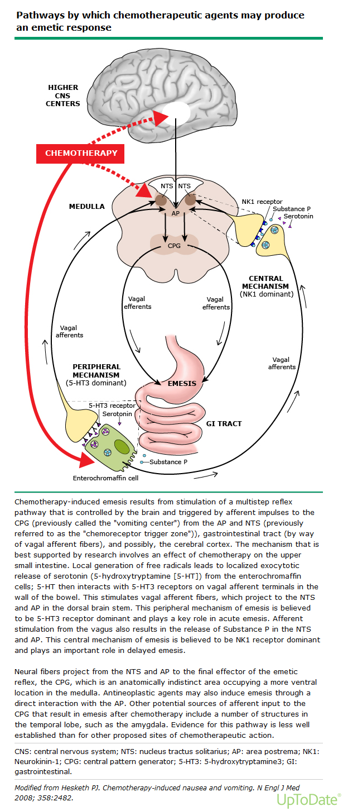

Slide 27
Before You Were Born
Which of the following was not the subject of a 1960’s tv sitcom?
A. A nun who was able to fly with the help of her habit
B. A man who’s deceased mother is reincarnated as a car
C. A man who’s uncle Martin is really a Martian
D. A man who’s best friend is a talking horse
E. A man who’s radio can turn back time

Slide 28
Before You Were Born
Which of the following was not the subject of a 1960’s tv sitcom?
A nun who was able to fly with the help of her habit
A man who’s deceased mother is reincarnated as a car
A man who’s uncle Martin is really a Martian
A man who’s best friend is a talking horse
A man who’s radio can turn back time
20
0 / 0
Cross-tab label

Slide 29




Before You Were Born

Slide 30
Question 9
Brittany S. is a 52 year old woman with a history of hypertensions, hyperlipidemia and prior MI. She takes aspirin, Lopressor and crestor. Her current BP is 130/75. You should:
Increase Brittany’s BP meds and aim for lower BP
Decrease Brittany’s BP meds and aim for a higher BP
Just leave Brittany alone!
20
0 / 0
Cross-tab label

Slide 31
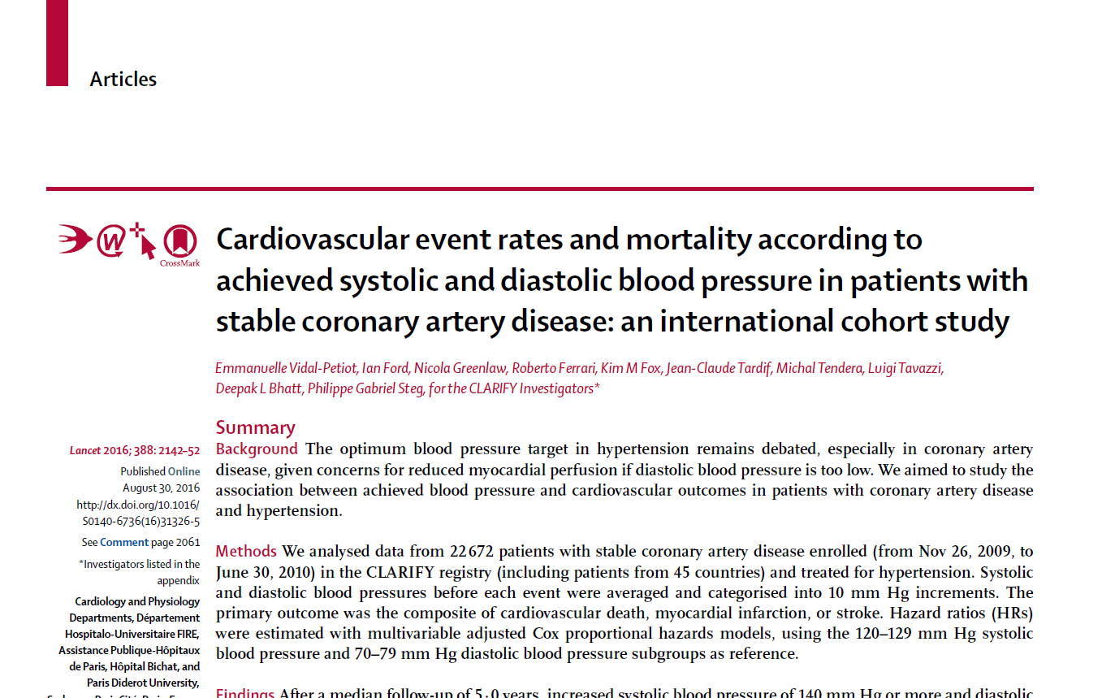
Lancet; 2016;388 (October 29): 2142 - 2152

Slide 32
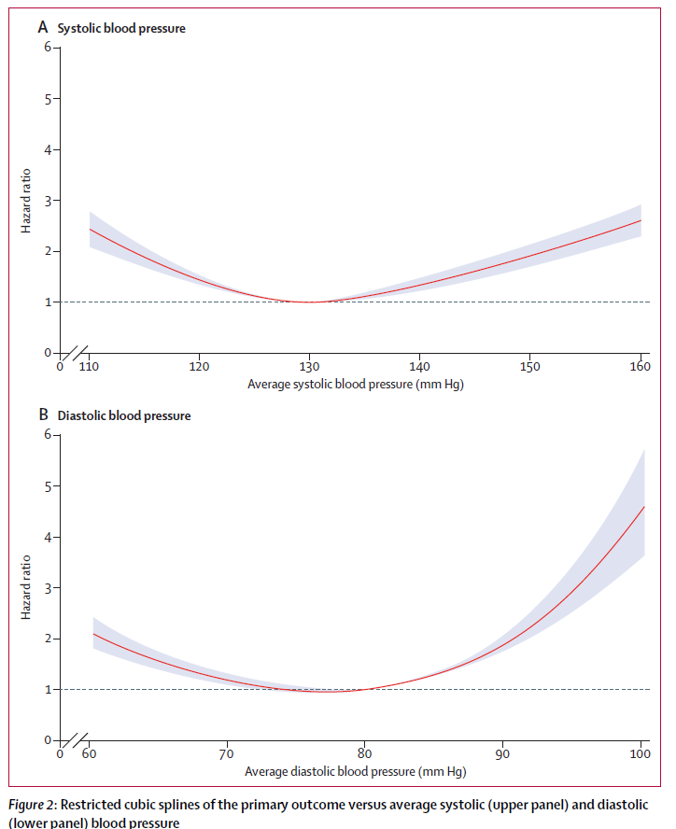
Your Friend and Mine, The J Shaped Curve

Slide 33
BP Treatment in Patients with CAD
Study of 22,672 patients with coronary artery disease and hypertension in the CLARIFY registry in 45 countries (history of MI, ASHD on angiogram, CABG or PTCA or chest pain with myocardial ischemia on imaging)
Outcome of CV death, MI or stroke was higher with SBP > 140 or < 130, DBP < 70 or > 80

Slide 34
Question 11
Sylvia Q is a 74 year old female complaining of fatigue since the demise of her Great Dane. Physical exam and labs are normal with the exception of a TSH of 11 (nml 0.3 – 4.5). Thyroid hormone supplementation has been shown to :
A. Improve fatigue
B. Decrease cardiovascular events
C. Increase daily pills ingested
D. Increase atrial fibrillation

Slide 35
Question 10
Sylvia Q is a 74 year old female complaining of fatigue since the demise of her Great Dane. Physicial exam and labs are normal with the exception of a TSH of 11 (nml 0.3-4.5). Thyroid hormone supplementation has been shown to:
Improve fatigue
Decrease cardiovascular events
Increase daily pills ingested
Increase atrial fibrillation
20
0 / 0
Cross-tab label

Slide 36
NEJM;2017;April 3rd (epublished)
737 patients age > 65 with persistent subclinical hypothyroidism (elevated TSH with normal fT4)
No changes at one year between placebo and active treatment in quality of life scores, fatigue scores, adverse events (although underpowered for adverse events and some epidemiologic studies suggest higher CV risk with subclinical hypothyroidism)
In some studies of elderly patients (JAMA 2004) elevated TSH associated with BETTER outcomes!
3/5 patients with one elevated TSH spontaneously reverted to normal on second check and were excluded from trial.
Most experts recommend treating levels > = 10

Slide 37
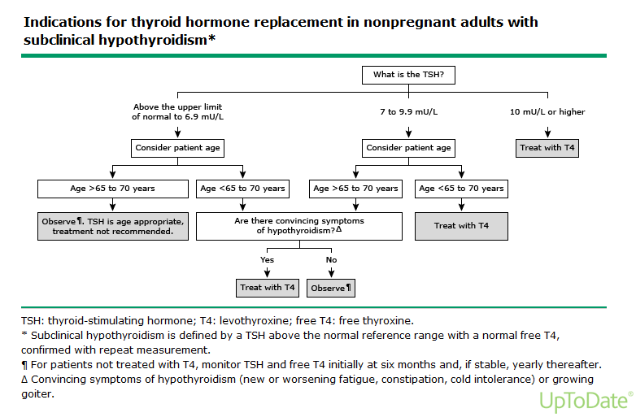

Slide 38
Question 11
Francois P. is a 42 year old male with depression who was recently prescribed aripiprazole (Abilify) by his psychiatrist. The addition of Abilify to treatment for depression has been shown to:
Cause of weight loss
Increase the risk of compulsive gambling
Improve depression in US patients
None of the above
20
0 / 0
Cross-tab label

Slide 39
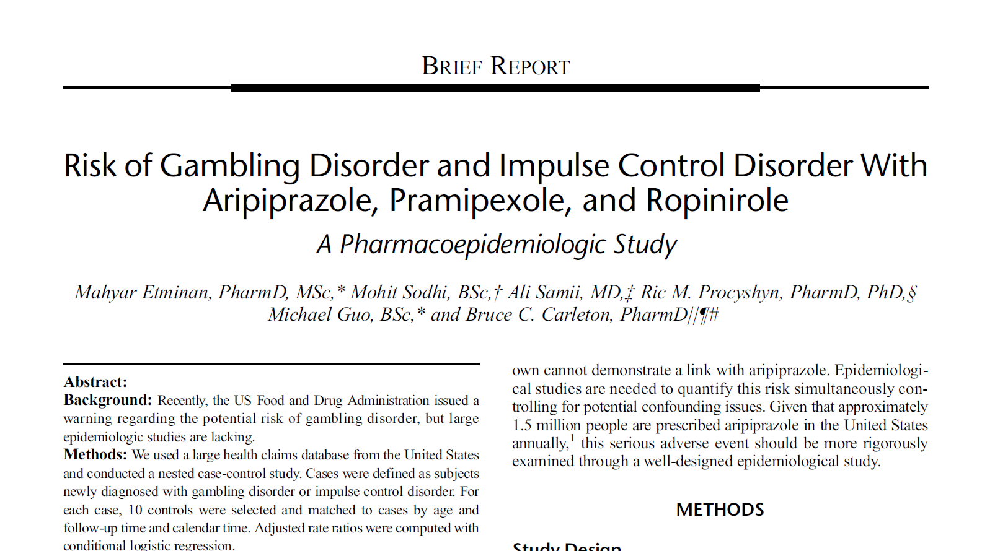
J Clin Psychopharmacol; 2017:37(February): 102 - 104

Slide 40
Impulse Control Disorders
Take your vitamin D3
Impulse control disorders are tied to dopamine D3 agonists
Nested case control study
RR of 5.23 for aripiprazole, 7.61 for pramipexole or ropinirole
May, 2016 FDA warning regarding ICD’s and aripiprazole
Doesn’t necessarily prove causation, but plausible biologically

Slide 41
Question 12
Mrs. Hirsch is a 72 year old woman admitted to the hospital with pneumonia and subsequently developed C difficile colitis. She was ill for a few weeks and required rehospitalization, but is now feeling better, eating and having formed stools. She is concerned about “what this all means”. The fact that Mrs. Hirsch developed C Diff has been associated with:
No changes in mortality rate as long as symptoms have resolved
A 1.5 fold increase in one year mortality
A mortality rate actually lower than age matched controls
2-3 times higher mortality rate than age matched controls
20
0 / 0
Cross-tab label

Slide 42
Patients from Medicare fee-for-service claims
Cases with C Diff were matched with controls
Using a CDI propensity control patients with C Diff had nearly a double mortality (42.6% vs 23.4%) and health care costs (looked at mortality at 20, 60, 180 days and 1 year after index episode)

Slide 43
Question 13
Mrs. Kent is a 68 year old smoker with moderately severe COPD who uses a combined long acting tiotropium and olodaterol comes in complaining of her back being “all tore up” after weeding her garden. Her neighbor gave her an oxycodone acetaminophen tablet which gave her substantial relief. In considering whether to give her a prescription for the oxycodone/acetaminophen:
There is a minimal increase in COPD exacerbations, but no increase in other adverse outcomes if you give her the prescription.
A new opioid prescription increases the risk of death in patients with COPD by 76%
A new opioid prescription doubles the risk of death related to COPD or pneumonia
A longer acting opioid, such as sustained release morphine, would be safer
2 and 3
20
0 / 0
Cross-tab label

Slide 44
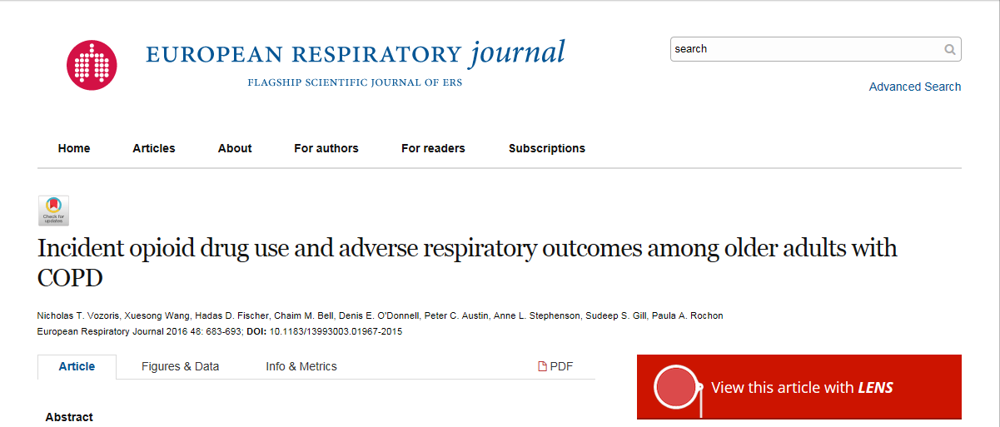

Slide 45
Adults > 66 year old in Canada with COPD studied 2007 to 2012
68.2% received a new opioid prescription!
Propensity score used to mitigate bias
New opioid rx =
  14% increase in ED visits
  COPD or pneumonia related deaths increased 216%
  All –cause mortality increased 76%
  Long acting opioids were more dangerous with 30 day mortality hazard ratio of 5.62

Slide 46
Case II
51 year old male with a history of DM II, CKD III, Htn who presented to the hospital with cough and pleurisy.
During hospitalization, he developed worsening renal failure and placed on dialysis.
He developed a large complex right pleural effusion and underwent decortication and chest tube placement.

Slide 47
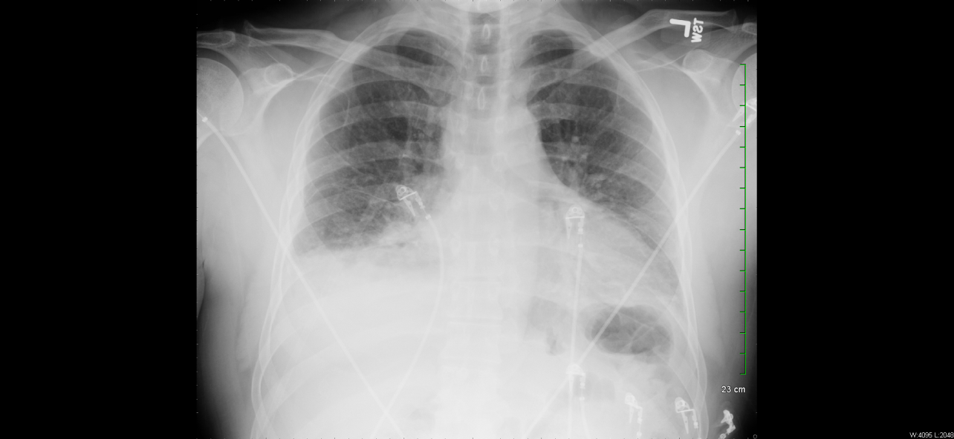
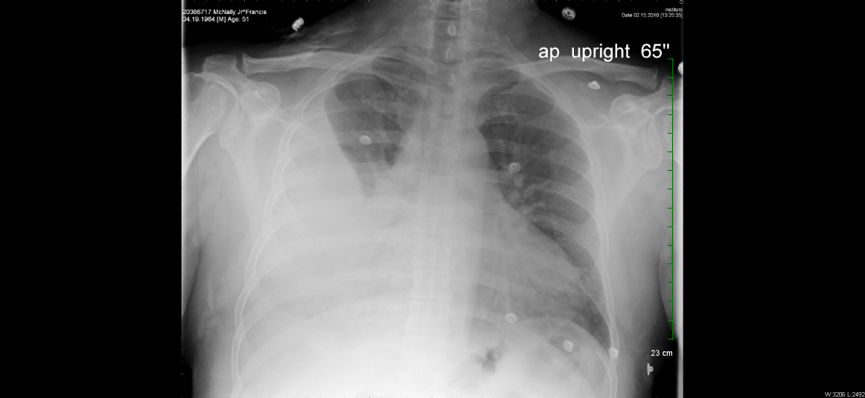
Case II

Slide 48
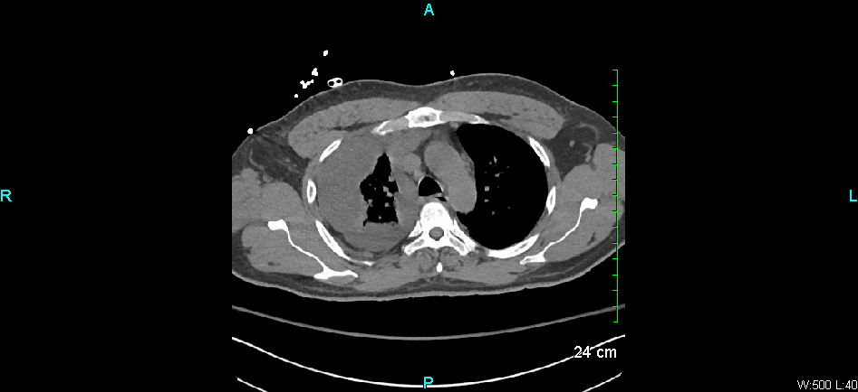
Case II

Slide 49
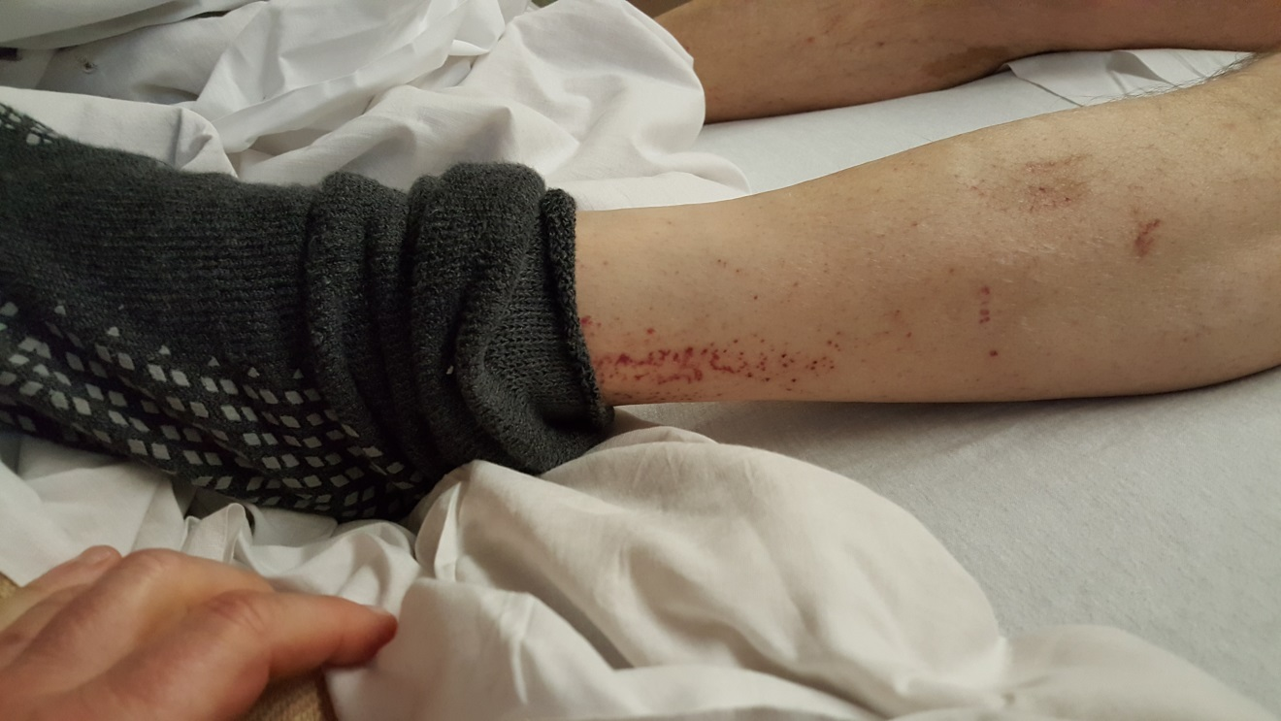
Case II
The patient’s leg, seen below, suggests:
A. Cellulitis
B. Drug Rash
C. Cardiac Emboli
D. Thrombocytopenia
E. Scabies

Slide 50
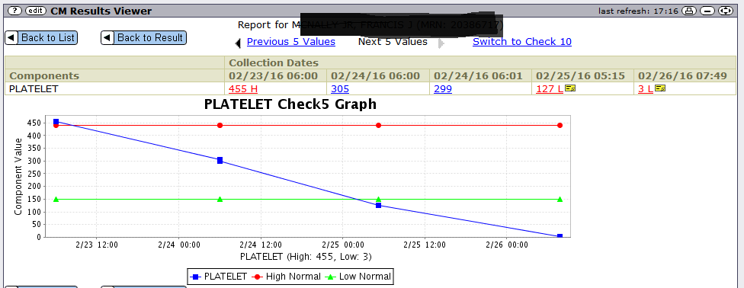
Case II
Patient developed oozing vascath site and epistaxis. He was afebrile, eating and drinking well. Platelet count seen below.

Slide 51
Case II
Meds included moxifloxacin, piperacillin-tazobactam, heparin, amlodipine, albumin, allopurinol.
What is the most likely reason for the thrombocytopenia?
A. Sepsis/Bone Marrow Suppression
B. HITT (heparin induced thrombocytopenia)
C. Antibiotic Associated thrombocytopenia
D. Sepsis/DIC

Slide 52
Case II
HITT – Caused by antibodies to platelet factor 4. Can see thrombosis, anphylaxis, skin reactions, venous and arterial thrombosis (technically “type II HIT”). Use 4 T’s Score. Treat with . Counts less than 20K are rare!
Sepsis seems unlikely
Drug induced – almost any drug! Can be due to
A. drug dependent, platelet-reactive antibodies (like penicillins)
B. A Primary ITP-like syndrome (some monoclonal antibodies)
C. Bone Marrow Suppression (daptomycin, linezolid, valproic acid)
Notes:
Thrombocytopenia
•Platelet count fall >50 percent and nadir ≥20,000/microL – 2 points
•Platelet count fall 30 to 50 percent or nadir 10 to 19,000/microL – 1 points
•Platelet count fall <30 percent or nadir <10,000/microL – 0 points
●Timing of platelet count fall
•Clear onset between days 5 and 10 or platelet count fall at ≤1 day if prior heparin exposure within the last 30 days – 2 points
•Consistent with fall at 5 to 10 days but unclear (eg, missing platelet counts), onset after day 10, or fall ≤1 day with prior heparin exposure within 30 to 100 days – 1 point
•Platelet count fall at <4 days without recent exposure – 0 points
●Thrombosis or other sequelae
•Confirmed new thrombosis, skin necrosis, or acute systemic reaction after intravenous unfractionated heparin bolus – 2 points
•Progressive or recurrent thrombosis, non-necrotizing (erythematous) skin lesions, or suspected thrombosis that has not been proven – 1 point
•None – 0 points
●Other causes for thrombocytopenia
•None apparent – 2 points
•Possible – 1 point
•Definite – 0 points
Interpretation — A point value for each of the four categories is determined, and the sum of these values gives a total from 0 to 8. Pretest probabilities for HIT are as follows:
●0 to 3 points – Low probability
●4 to 5 points – Intermediate probability
●6 to 8 points – High probability

Slide 53
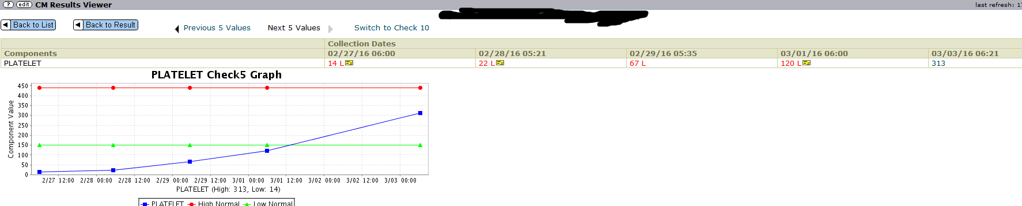
Case II
Piperacillin-tazobactam and moxifloxacin stopped 2/26! It’s gotta be the zosyn!

Slide 54
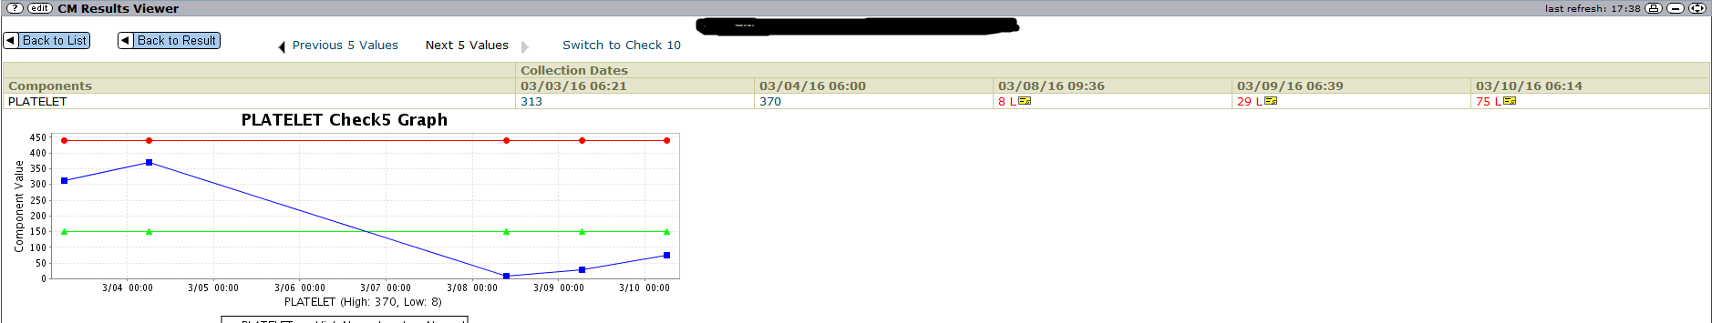
Case II
Moxifloxacin restarted! (Oops, Mr. Smarty Pants)

