Slide 1


How to Further Reduce Cardiovascular Events:
Management of LDL-C
Beyond Statins
Synergy
Cardiac E/P Update
Subodh K Agrawal, MD FACC

Slide 2
Case Presentation #1
Mr. A, 60 Yrs old, returns to your office 6 weeks after Acute anterior myocardial episode, which was intercepted by Emergent PCI by placing a drug eluting stent. He has return to work and feeling well. He is accompanied by his 20 year old son Joe, who is in college and studying to be a physician.
Mr. A smokes 5 cigar a day, and works 14 hour/day in his Law practice. He has not seen a physician in last 10 years, until his first heart attack 6 weeks ago.
His father had MI at age 55 and died, Mother is 85 year old and active
Physical Exam: BP 130/80, BMI 36. Truncal obesity

Slide 3

Case Presentation #1
His current medications include ,
ASA, 81mg once a day
Coreg, 6.2mg twice a day
Elanapril 5 mg/day
Atrovastatin 80 mg/day
Brilinta 90mg twice a day
NTG 0.4mg sl prn for angina
Lipid Profile
Total cholesterol 200mg/dl
HDL 35 mg/dl
Triglyceride 200
LDL 145

Slide 4
Case Presentation #1
What is the Next Step in Reducing the Chance of Another CV Event in the Next 20 Years?
Exercise, low fat diet, lifestyle change
Exercise, Mediterranean diet, lifestyle change
Tobacco cessation
Add ezetimibe 10mg/day in addition to Atorvastatin 80mg/day
All of the above
Only 2, 3 and 4
Cross-tab label
15
3 / 6

Slide 5
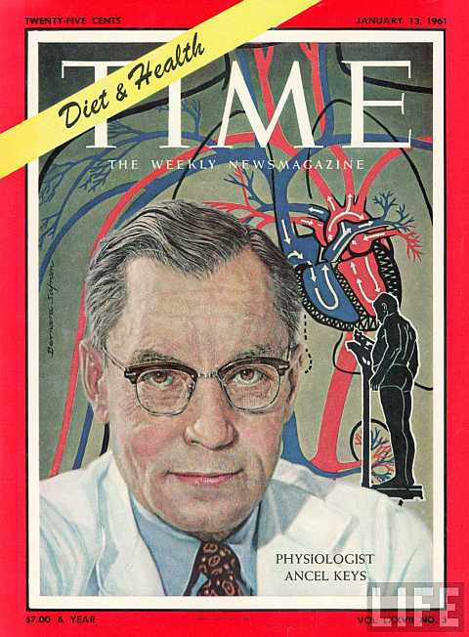
Mediterranean Diet and Heart Disease
Seven Countries Study (1968)
Disease rates and dietary patterns differed across countries
Mediterranean diet responsible?
RESEARCH
Keys et al., 1986
Notes:
People: 7447 adults at risk of heart disease
Groups: Med diet and olive oil
Med diet and nuts
Low fat diet
Outcome: Heart related death, heart attack, stroke or diabetes
Duration: 5 years

Slide 6
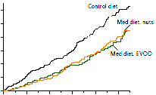
PREDIMED Study
Heart events over 5 years
60
Low fat diet
50
Med diet + nuts
% of people who had heart event
40
30
20
Med diet + olive oil
10
0
0 1 2 3 4 5
Year
Estruch et al., 2013
Notes:
30% reduction in risk of heart disease
52% reduction in risk of diabetes
27% reduction in risk of heart disease with statin treatment
30% reduction in risk of diabetes with metformin treatment

Slide 7
Case Presentation #1
Mr. A return after 6 months of his MI, with his 30 year old Daughter who is very concerned about the possible recurrence of MI in next future. He has started exercising, lost 10 Lb and has started doing yoga for stress reduction. His lipid profile was done 3 days ago:
Total cholesterol: 180mg/dl
HDL 37mg/dl
Triglyceride 155mg/dl
LDL 95mg/dl

Slide 8
Case Presentation #1
What is your next step?
Prescribe evolocumab (Repatha)
Prescribe alirocumab (Praluent)
Ask her daughter to have her lipid profile done if not done in last 5 years
No change in regimen, follow up in 6 months
1, 2, and 3
20
0 / 0
Cross-tab label

Slide 9
Case Presentation #1
Next step in management to reduce future risk for cardiovascular events is
1. add Repatha
2. Add Praluent
3. No additional therapy
4.Add Co Q 10
5. 1 & 2

Slide 10
Case Presentation #1
What is the next step in management to reduce future risk for cardiovascular events?
Add Repatha
Add Praluent
No additional therapy
Add Co Q10
1&2
20
0 / 0
Cross-tab label

Slide 11

FOURIER
Further Cardiovascular OUtcomes Research with PCSK9 Inhibition in Subjects with Elevated Risk
MS Sabatine, RP Giugliano, AC Keech, N Honarpour,
SM Wasserman, PS Sever, and TR Pedersen,
for the FOURIER Steering Committee & Investigators
American College of Cardiology – 66th Annual Scientific Session
Late-Breaking Clinical Trial
March 17, 2017
Notes:
In patients with established cardiovascular disease
on statin therapy:
Test whether the addition of evolocumab reduces the incidence of major cardiovascular events
Examine the long-term safety & tolerability of evolocumab
Investigate the efficacy and safety of achieving unprecedented low levels of LDL-C

Slide 12
Trial Design
27,564 high-risk, stable patients with established CV disease (prior MI, prior stroke, or symptomatic PAD)
Screening, Lipid Stabilization, and Placebo Run-in
High or moderate intensity statin therapy (± ezetimibe)
LDL-C ≥70 mg/dL or
non-HDL-C ≥100 mg/dL
RANDOMIZED
DOUBLE BLIND
Evolocumab SC
140 mg Q2W or 420 mg QM
Placebo SC
Q2W or QM
Follow-up Q 12 weeks
Sabatine MS et al. Am Heart J 2016;173:94-101

Slide 13
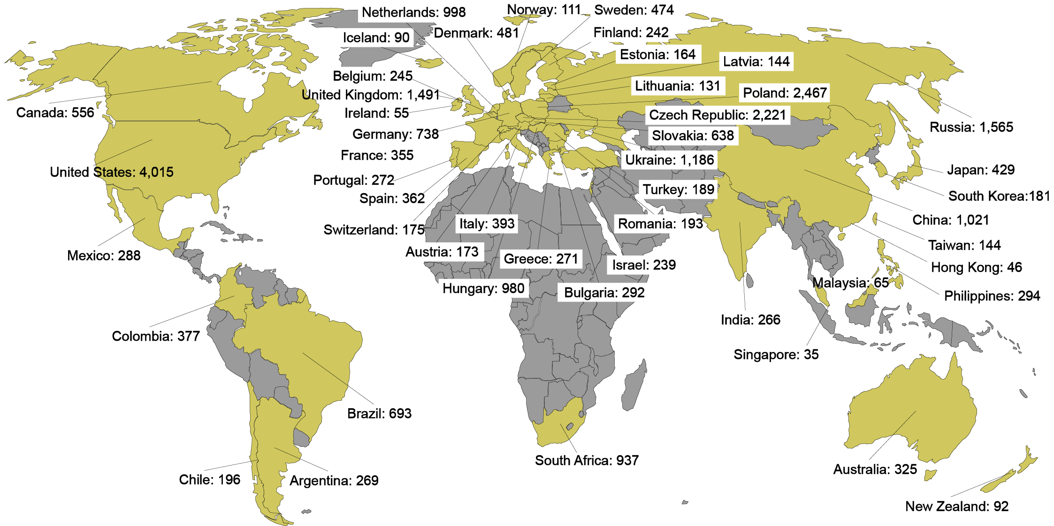

Global Enrollment
27,564 patients randomized at 1242 sites
in 49 countries between 2/2013 – 6/2015
An Academic Research Organization of
Brigham and Women’s Hospital and Harvard Medical School

Slide 14
Lipid Lowering Therapy
& Lipid Levels at Baseline
Characteristic | Value
Statin use (%)*
High-intensity | 69
Moderate-intensity | 30
Ezetimibe use (%) | 5
Median lipid measures (IQR) – mg/dL
LDL-C | 92 (80-109)
Total cholesterol | 168 (151-189)
HDL-C | 44 (37-53)
Triglycerides | 133 (100-182)
*Per protocol, patients were to be on atorva ≥20 mg/d or equivalent.
1% were on low intensity or intensity data were missing.
Statin intensity defined per ACC/AHA 2013 Cholesterol Guidelines.
Pooled data; no differences between treatment arms

Slide 18
Safety
 | Evolocumab (N=13,769) | Placebo (N=13,756)
Adverse events (%)
Any | 77.4 | 77.4
Serious | 24.8 | 24.7
Allergic reaction | 3.1 | 2.9
Injection-site reaction | 2.1 | 1.6
Treatment-related and led to d/c of study drug | 1.6 | 1.5
Muscle-related | 5.0 | 4.8
Cataract | 1.7 | 1.8
Diabetes (new-onset) | 8.1 | 7.7
Neurocognitive | 1.6 | 1.5
Laboratory results (%)
Binding Ab | 0.3 | n/a
Neutralizing Ab | none | n/a
New-onset diabetes assessed in patients without diabetes at baseline; adjudicated by CEC

Slide 19
EBBINGHAUS:
Evaluating PCSK9 Binding Antibody Influence on
Cognitive Health in High Cardiovascular Risk Subjects
N=1,974 patients from FOURIER Study, followed for 96 weeks
EBBINGHAUS is the first prospectively designed study to evaluate the relationship between PCSK9 inhibition and changes in cognition, including memory, attention, and reaction time
The mean change in the primary endpoint of executive function, as measured by the Spatial Working Memory strategy index (from the Cambridge Neuropsychological Test Automated Battery), was -0.29 with placebo and -0.21 with evolocumab (P<0.0001 for non-inferiority)
All secondary outcomes were similar for placebo and evolocumab, including patient self-reports and investigator-reported cognitive adverse events
Abbreviations: FOURIER, Further Cardiovascular Outcomes Research with PCSK9 Inhibition in Subjects With Elevated Risk trial;
PCSK9, proprotein convertase subtilisin/kexin type 9.
https://clinicaltrials.gov/ct2/show/NCT02207634;
http://www.acc.org/latest-in-cardiology/articles/2017/03/13/17/44/sat-8am-ebbinghaus-cognitive-study-of-patients-enrolled-in-fourier-acc-2017?w_nav=LC;
https://challengesincardiology.com/ebbinghaus-a-cognitive-study-of-patients-enrolled-in-the-fourier-trial/.

Slide 20

PCSK9 Increases degradation of LDL-C receptors
Davidson M. Nature Rev Cardiol 2013; 10: 618-19; Brautbar, A. & Ballantyne, C. M. (2011) Nat. Rev. Cardiol. doi:10.1038/nrcardio.2011.2
Notes:
HOT TOPICS IN CHOLESTEROL
PCSK9, produced in the liver and then secreted, binds to the LDL receptor-LDL complex on the surface of the hepatocyte and gets internalized. Upon dissociation from LDL, the LDLR- PCSK9 complex is routed to the lysosome for degradation of the LDL-R

Slide 21
Summary for Evolocumab
↓ LDL-C by 59%
  Consistent throughout duration of trial
  Median achieved LDL-C of 30 mg/dl (IQR 19-46 mg/dl)
↓ CV outcomes in patients already on statin therapy
  15% ↓ broad primary endpoint; 20% ↓ CV death, MI, or stroke
  Consistent benefit, incl. in those on high-intensity statin, low LDL-C
  25% reduction in CV death, MI, or stroke after 1st year
  Long-term benefits consistent w/ statins per mmol/L ↓ LDL-C
Safe and well-tolerated
  Similar rates of AEs, incl DM & neurocog events w/ EvoMab & pbo
  Rates of EvoMab discontinuation low and no greater than pbo
  No neutralizing antibodies developed

Slide 22
Lowering LDL-C May…
Prevent progression of atherosclerosis
Cause regression of atherosclerosis
I don’t know
I don’t care
20
0 / 0
Cross-tab label

Slide 23

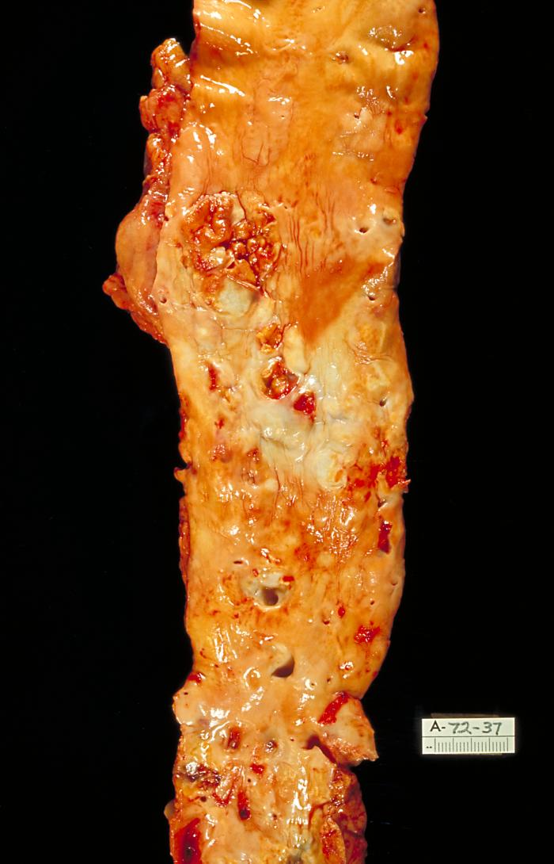
How Can we Prevent This?

Slide 24
Atherosclerosis in Children
Bogalusa Heart Study
  Autopsies on young people with accidental cause of death
  Found prevalence of fatty streaks and/or fibrous plaques by young adulthood of ~ 70%
  Degree of atherosclerosis correlates directly with elevated total cholesterol, LDL, and TG
  Negative correlation with HDL level
PDAY Study (Pathological Determinants of Atherosclerosis in Youth)
  Evaluated 3,000 children age 15-34 who died of accidental causes
  demonstrated the presence of early signs of atherosclerosis
  showed an association between elevated cholesterol and degree of pathology (fatty streaks and fibrous plaques)
McGill et al. Circulation. 2001; 103 (11): 1546-1550.
Newman et al. N Eng J Med. 1986; 314 (3): 138-144.

Slide 25
What is Normal Serum LDL for a Human?
130mg/dl or less
100mg/dl or less
70mg/dl or less
50mg/dl or less
25mg/dl or less
20
0 / 0
Cross-tab label

Slide 26
What is Normal LDL?
Umbilical blood in range of 50 mg/dl
Hypobetalipoproteinemia can have normal survival
LDL receptors 50% saturated at 10 mg/dl
Most mammals have LDL of 50-70 mg/dl

Slide 27
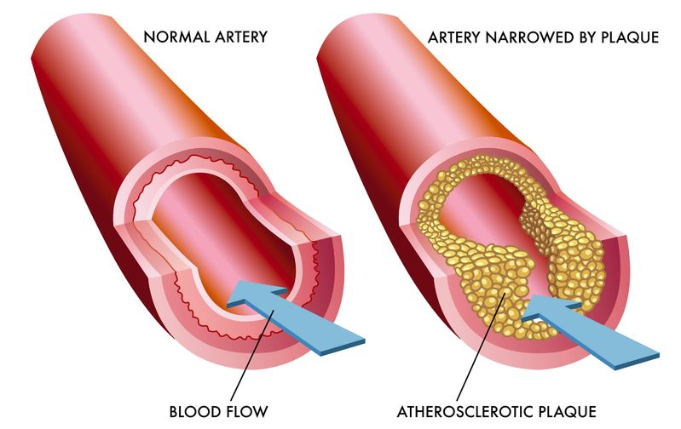
Life Long Reduction of Exposure To High LDL in Humans Lead to Reduce Atherosclerosis

Slide 28
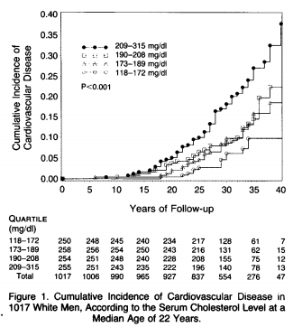
Effect of Life Long Reduction of LDL on CV Event

Slide 29
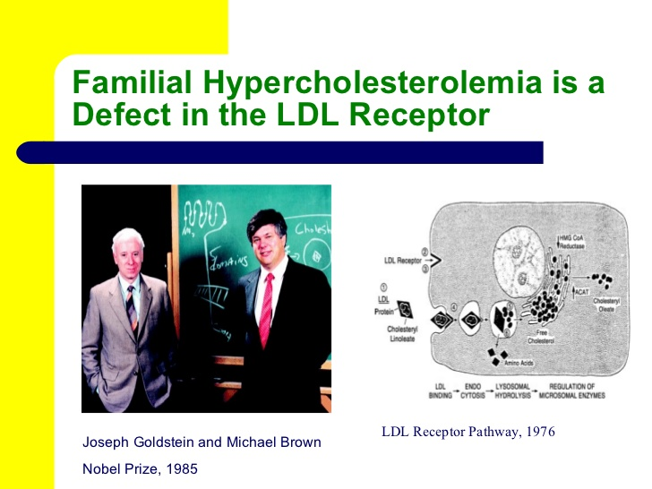

Slide 30
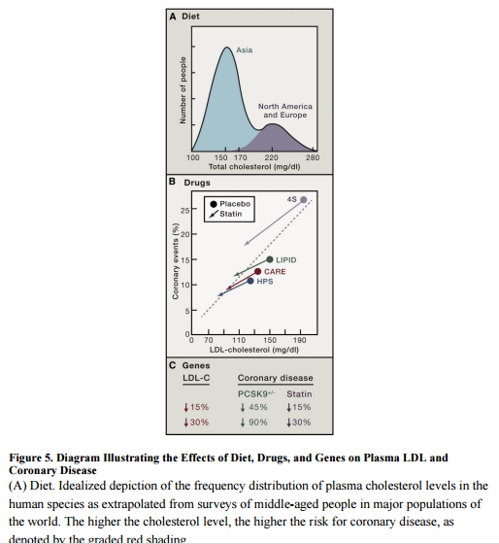
Effect of Diet, Drugs and Genes on Plasma Levels of LDL and Coronary Disease

Slide 31
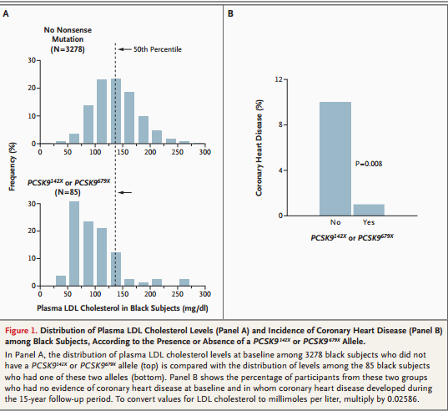
Effect of Life Long Reduction of LDL on CV Event

Slide 32
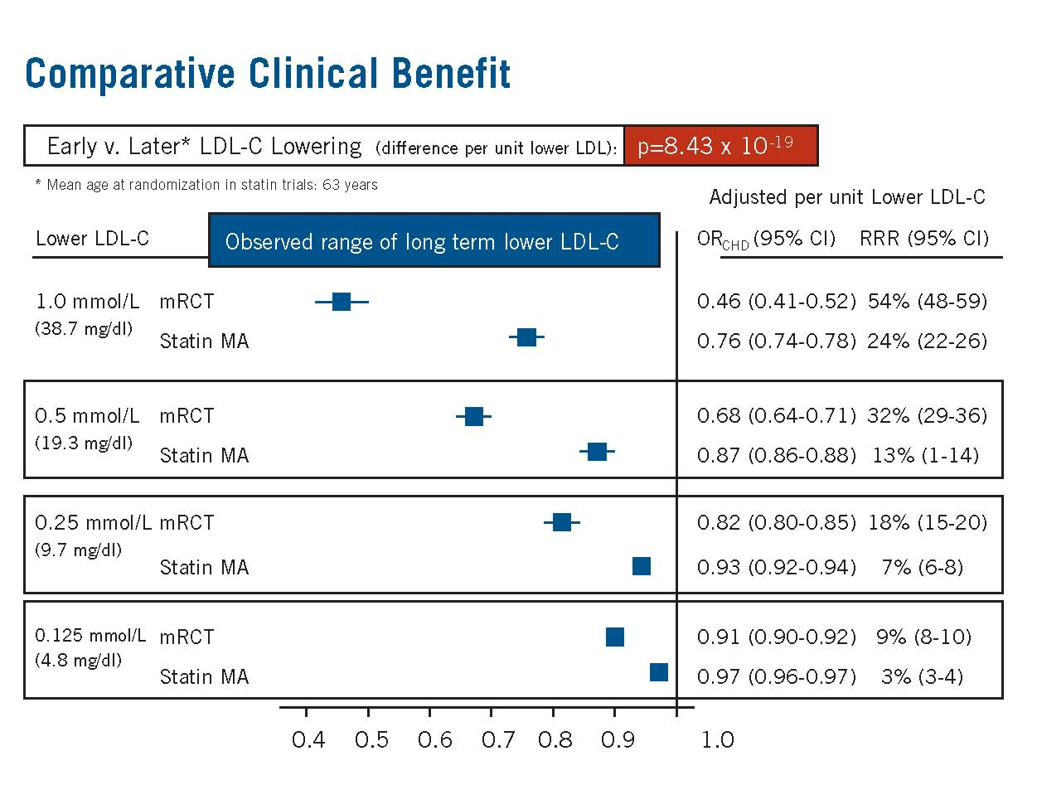
Early LDL Reduction
Brian A. Ference, MD, MPhil, MSc
Objective
  Mendelian randomized controlled trial of long term reduction in low-density lipoprotein cholesterol (LDL-C) beginning early in life
  Use allele associated with lower LDL-C as
  proxy for treatment that lowers LDL-C
  beginning at birth, to estimate clinical benefit
  of lowering LDL-C beginning early in life
Methods
  Studies involving 9 SNPs from 6 different
  genes
  Randomization to allele associated with lower LDL-C (treatment arm) or other allele (usual
  care arm)
  Primary analysis: Association between
  exposure allele and CHD
    Primary endpoint: CHD (CV death, MI,
    coronary revascularization)

Slide 33
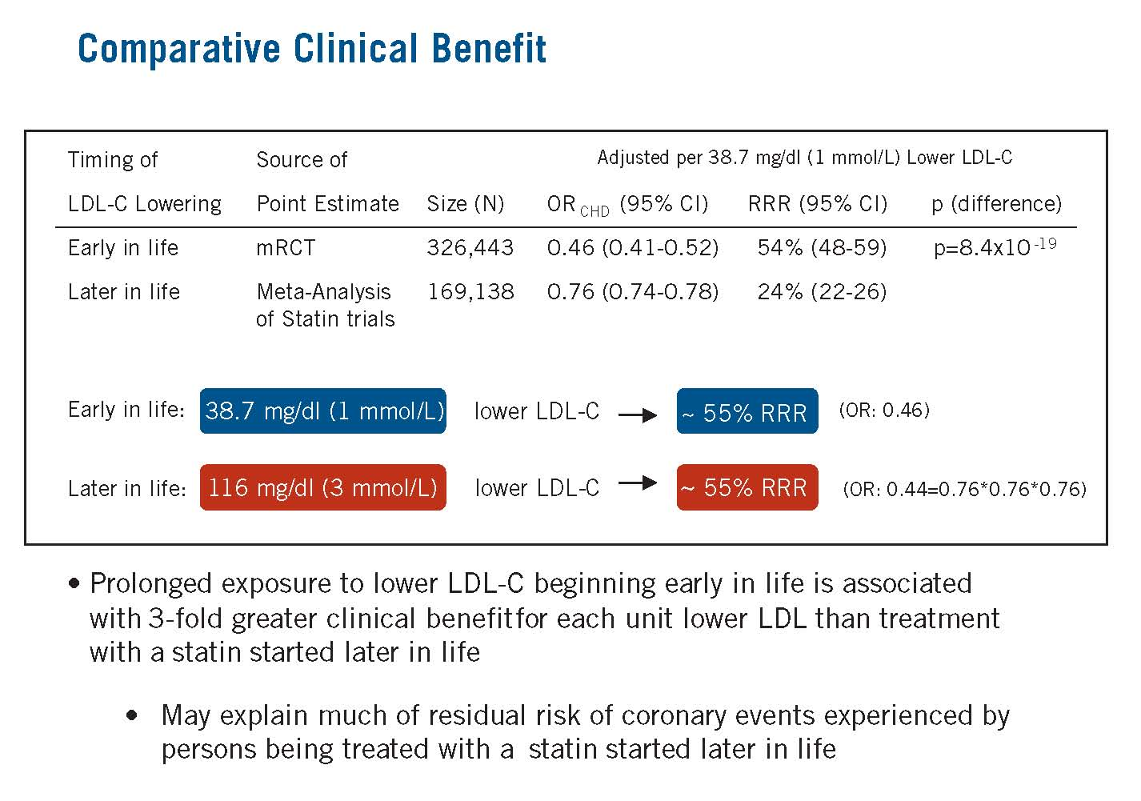
Early LDL Reduction
Results
  Prolonged exposure to lower LDL-C beginning early in life associated with 3-fold greater clinical benefit for each unit lower LDL-C than treatment with a statin started later in life
Conclusions
  Clinical benefit of lowering LDL-C depends on both timing and magnitude of LDL-C reduction
  Prolonged exposure to lower LDL-C beginning early in life (before development of atherosclerosis) substantially more effective at reducing CHD risk than current practice of lower LDL-C beginning later in life (after development of atherosclerosis).
  This increased clinical benefit appears to be independent of the mechanism of LDL-C lowering

Slide 34
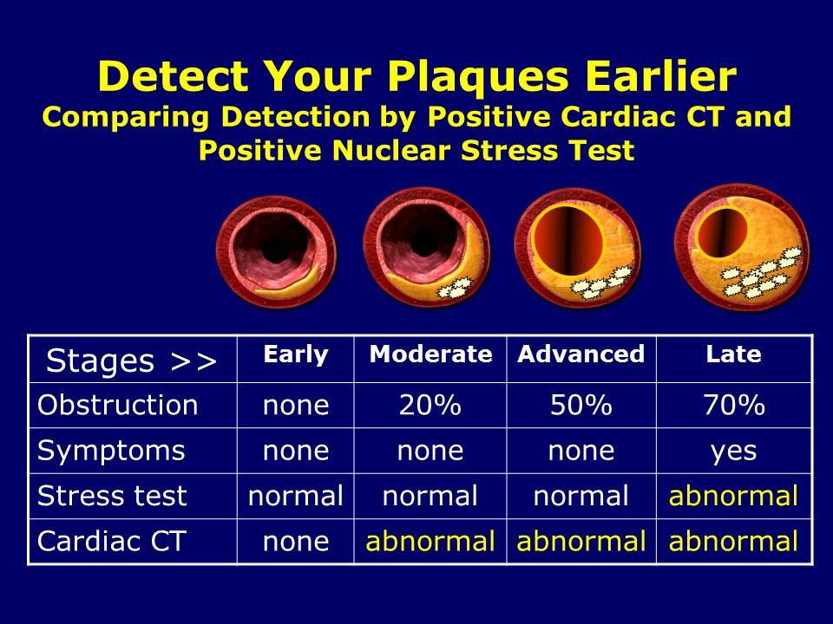

Slide 35
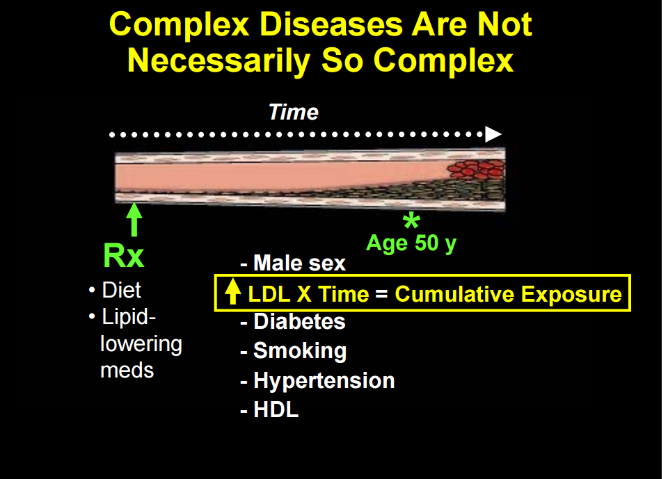
Life Long Reduction of Exposure to Elevated LDL

Slide 36
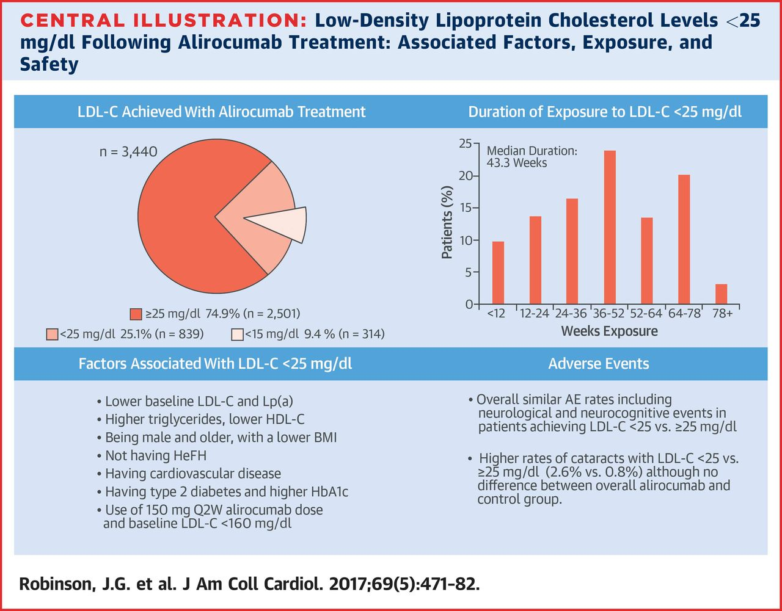


Slide 37
Atherosclerosis in Children
Bogalusa Heart Study
  Autopsies on young people with accidental cause of death
  Found prevalence of fatty streaks and/or fibrous plaques by young adulthood of ~ 70%
  Degree of atherosclerosis correlates directly with elevated total cholesterol, LDL, and TG
  Negative correlation with HDL level
PDAY Study (Pathological Determinants of Atherosclerosis in Youth)
  Evaluated 3,000 children age 15-34 who died of accidental causes
  demonstrated the presence of early signs of atherosclerosis
  showed an association between elevated cholesterol and degree of pathology (fatty streaks and fibrous plaques)
McGill et al. Circulation. 2001; 103 (11): 1546-1550.
Newman et al. N Eng J Med. 1986; 314 (3): 138-144.

Slide 38
AAP Recommendations 2008
How should we screen?
  Fasting lipid panel recommended
What’s abnormal?
  1992 NCEP Guidelines for total and LDL cholesterol cut offs in children and adolescents
Category | Percentile | Total Cholesterol (mg/dL) | LDL (mg/dL)
Acceptable | <75th | <170 | <110
Borderline | 75th-95th | 170-199 | 110-129
Elevated | >95th | >200 | >130
Daniels, S. et al. Lipid Screening and Cardiovascular Health in Childhood. Pediatrics 2008: 122; 198-208

Slide 39
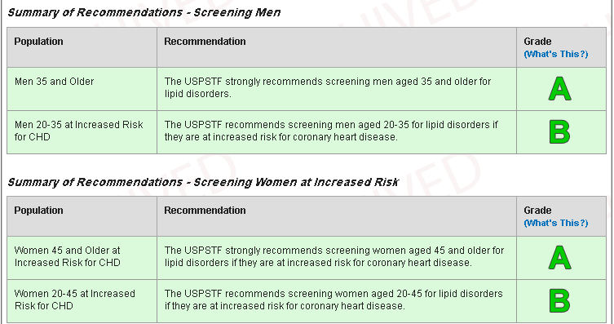
The U.S. Preventive Services Task Force Recommends

Slide 40
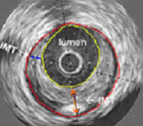
GLAGOV: Mean On-Treatment LDL-C vs.
Change in Percent Atheroma Volume
The GLAGOV multicenter, double-blind, placebo-controlled, randomized clinical trial
(enrollment 5/2013 to 1/2015) conducted at 197 academic and community hospitals in 6 continents, enrolling 968 patients (mean age 59.8 years, 27.8% female) with CAD
Patients with angiographic CAD were randomized to receive monthly evolocumab (420 mg) (n=484) or placebo (n=484) SQ for 76 weeks, in addition to statins
Locally weighted polynomial regression (LOESS) plot demonstrates a linear continuous relationship between achieved LDL-C level and PAV progression/ regression for levels of LDL-C ranging from 110 mg/dL
to as low as 20 mg/dL
Change In Percent Atheroma Volume (%)
Achieved On-Treatment LDL-C (mg/dL)
Abbreviations: CAD, coronary artery disease; GLAGOV, Global Assessment of Plaque Regression With a PCSK9 Antibody ;LDL-C, low-density lipoprotein
cholesterol; SQ, subcutaneous.
Nicholls SJ. JAMA. 2016;316(22):2373-2384.
Notes:
In statin-treated patients with symptomatic coronary disease, addition of evolocumab, 420 mg monthly for 18 months:
Achieved LDL-C levels averaging 36.6 mg/dL compared
with 93 mg/dL for a statin alone.
Produced regression, mean change in PAV of -0.95% compared with +0.05% in statin-only patients, (P<0.0001).
Induced regression in a greater percentage of patients, 64% vs. 47% (P<.0.0001).
Post hoc analysis showed a incremental benefit for combination therapy at LDL-C levels as low as 20 mg/dL

Slide 41
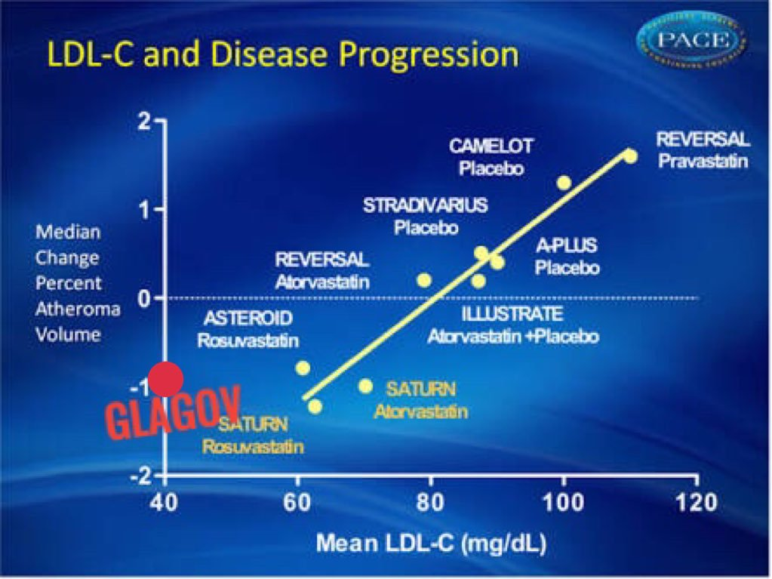

Slide 42
Patients with High CV Risk Face Challenges in Achieving LDL-C Goals
Statins are the standard of care for HC management
However, many patients are not reaching their recommended
LDL­­-C goal with statin therapy¹⁻³
High risk patients¹
HeFH patients^{2,3}
LDL-C Goal <100 mg/dL
LDL-C Goal <70 mg/dL
LDL-C Goal <100 mg/dL
23% not at goal
76% not at goal
~80% not at goal
1. Jones PH, et al. J Am Heart Assoc. 2012;1:e001800. doi: 10.1161/JAHA.112.001800. 2. Stein EA, et al. Am J Cardiol. 2003;92:1287–1293. 3. Pijlman AH, et al. Atherosclerosis. 2010;209:189–194.
HC, hypercholesterolemia; HeFH, heterozygous familial hypercholesterolemia.
Notes:
Statins are the standard of care for raised LDL-C management
However, many patients are not reaching their recommended LDL-C goal with statin therapy due to suboptimal reductions
in LDL-C (i.e. up to 76% of high risk patients and 80% of HeFH patients are not achieving their LDL-C goal)
1. Jones et al 2012: pg4/table 2
2. Stein et al 2003: pg1291/table3
3. Pijlman et al 2010: pg191/table1
1. Jones et al 2012: pg4/table 2
2. Stein et al 2003: pg1291/table3
3. Pijlman et al 2010: pg191/table1

Slide 43
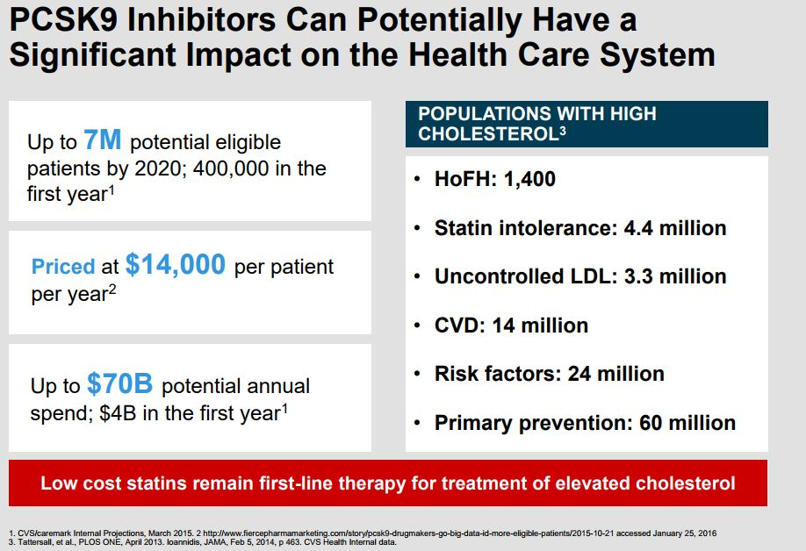

Slide 44
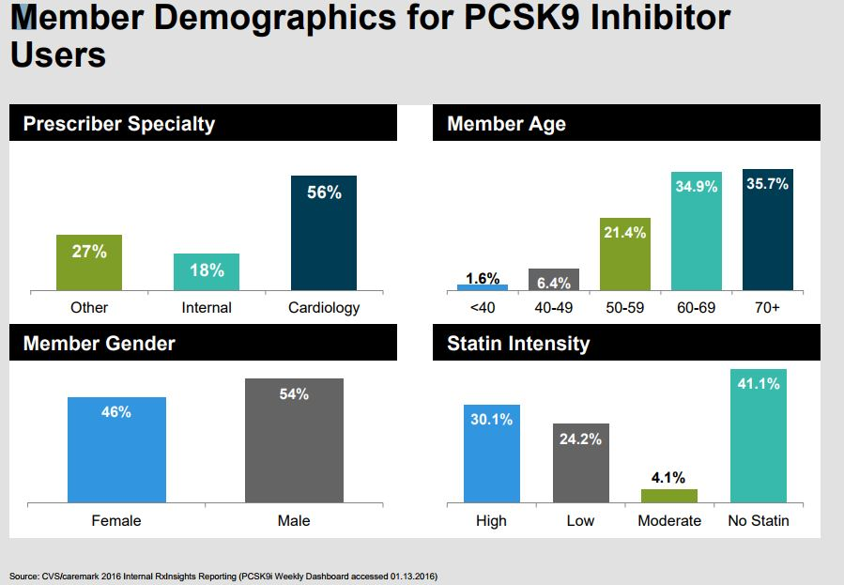

Slide 45

Possible Cause of Statin Intolerance:
Natural Health School and Food Industries

Slide 46
Identifying True Statin Intolerance
Prevalence of statin intolerance is difficult to define and there is no universally accepted definition
Some patients can be successfully rechallenged, questioning the diagnosis
Patient preference also plays a role
Statin intolerance is a clinical syndrome that is:
Characterized by inability to use statins long-term due to signiﬁcant symptoms and/or biochemical abnormalities
Either ‘complete’ (intolerant to any statin at any dose) or ‘partial’ (intolerant to some statins at some doses)
Not attributable to established predispositions such as drug-drug interactions, untreated hypothyroidism, febrile illness, etc¹
1. Mancini GB, et al. Can J Cardiol. 2013;29(12):1553–68.
Notes:
Reference:
Mancini GB, et al. Diagnosis, prevention, and management of statin adverse effects and intolerance Canadian Working Group Consensus Update. Can J Cardiol. 2013;29:61553-1568.

Slide 47
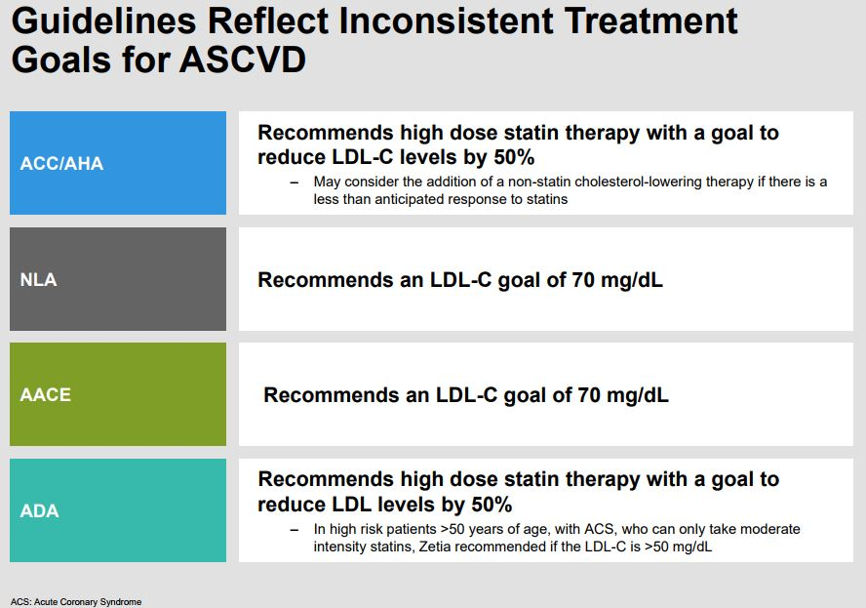

Slide 48
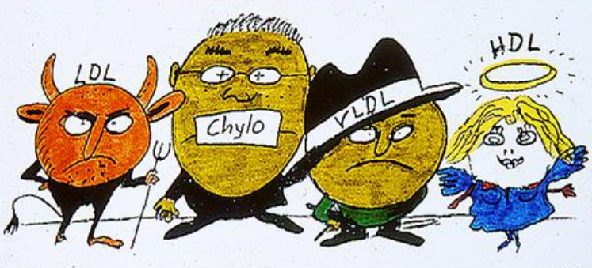

Slide 49
Reduce Life long Exposure to Elevated LDL and Slow Down Progression of Atherosclerosis
Start earlier then waiting for CV event.
Lower LDL and Non HDL cholesterol goal is better then currently Published guidelines
Bring Genetics in your practice and Think three generations
Use all available lipid lowering therapy, Statin First
document intolerance to statin LDL
Targeting Low HDL-C & HDL-P by drug therapy is not supported by data currently.
Notes:
For patients currently on statin therapy who develop SIM,
initiate a six week statin holiday and assess reason for possible increase in statin levels 13
A. Statin metabolism a) Choosing a statin metabolized by a different enzymatic system may improve tolerability i. Lovastatin, simvastatin and atorvastatin are metabolized by the CYP450 3A4 system in the liver ii. Pravastatin, rosuvastatin, fluvastatin, and pitivastatin are metabolized by alternate pathways
B. Lipophilicity a) Hydrophilic statins such as pravastatin, rosuvastatin, and fluvastatin are least likely to cause myopathy Initiate re-trial of statin therapy with a different statin, considering drug interactions and statin lipophilicity, at equivalent dosing a) 43% tolerated the new statin without reporting symptoms
14 II. If failure to statin re-trial, initiate a “drug holiday” and retrial statin therapy with a more potent statin alternative at a lower dose
A. Atorvastatin and rosuvastatin are the two more potent statins
B. Studies have demonstrated re-trial of more potent statin at a lower dose is effective LDL lowering therapy and majority of patients with previous statin intolerance are able tolerate this alternative 17 III. If failure after the first two alternatives and patient has risk factors for vitamin D deficiency, assess vitamin D level A. Determine if treatment is necessary based on vitamin D level B. Vitamin D

Slide 50


