Slide 1
Interactive Session- Let’s Talk Orthostatic Hypotension
Subodh Agrawal MD, FACC
Niraj Sharma MD, FACC, FHRS

Slide 2
Case Presentation # 1
A 46-year-old healthy female noticed progressive, severe, lightheadedness over 6 months. She had multiple falls and syncope and has been admitted twice to the hospital in last 2 months. She also reported dry mouth, bowel hypomotility, and urinary urgency.
Evaluation after a syncopal event revealed dilated non-reactive pupils. Supine blood pressure was 160/90 mmHg and standing blood pressure 60/40 mmHg . Reflexes were normal and sensory examination unremarkable. She has unsteady gait.
Medication: Atenolol, Midodrine, and Fludrocortisone

Slide 3
What is the Next Step in Management of This Patient?
Wheel chair for ambulation
Trial of Northera (droxidopa)
Salt and fluid loading
All of the above
14
36 / 150
Cross-tab label

Slide 4
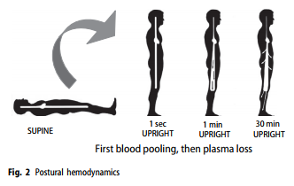
Postural Hemodynamics

Slide 5
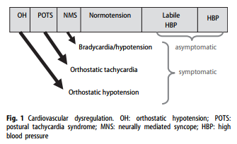
Cardiovascular Dysregulation

Slide 6
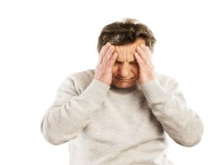
Causes of Orthostatic Hypotension
Predisposing Factors
Dehydration
Deconditioning
Nutritional
Aging
Medications
Tricyclic antidepressants (chronic)
Antihypertensives and diuretics
Vasodilators
Tizanidine (Zanaflex)

Slide 7
Neurogenic Orthostatic Hypotension
Autonomic neuropathy
Pure Autonomic failure
Parkinson’s Disease
Multiple system atrophy
Dementia with Lewy Bodies
Dopamine β hydroxylase deficiency
Brainstem lesions
Spinal Cord injury

Slide 8
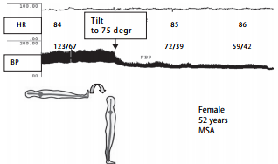
Orthostatic Hypotension in Autonomic Failure

Slide 9
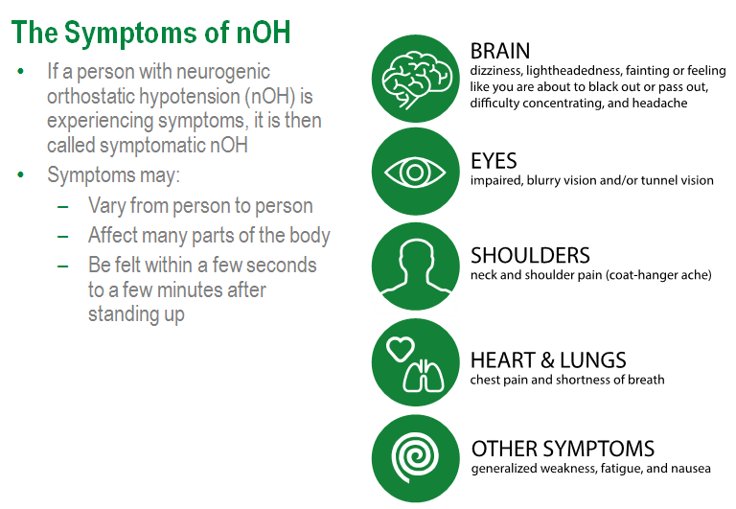
Neurogenic Orthostatic Syncope (nOH) Orphan disease

Slide 12
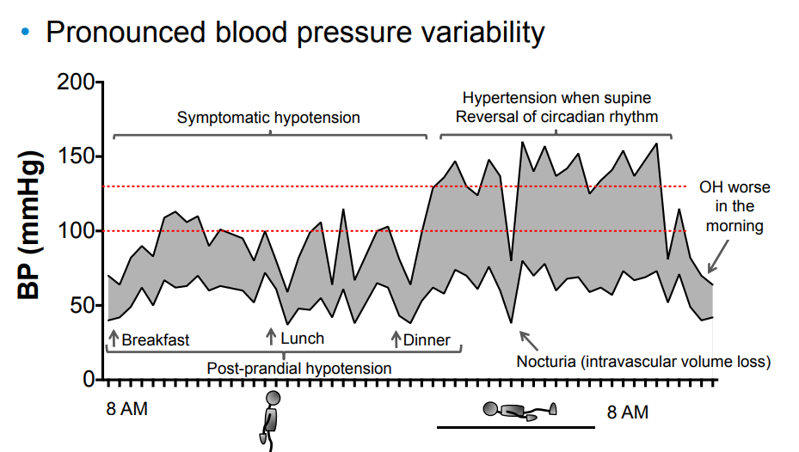

Slide 15
Northera (droxidopa) Indication
Indication: NORTHERA® (droxidopa) is indicated for the treatment of orthostatic dizziness, lightheadedness, or the “feeling that you are about to black out” in adult patients with symptomatic neurogenic orthostatic hypotension (NOH) caused by primary autonomic failure (Parkinson’s disease, multiple system atrophy, and pure autonomic failure), dopamine beta-hydroxylase deficiency, and non-diabetic autonomic neuropathy
Dosing: Titrate to symptomatic response, in increments of 100 mg three times daily every 24 to 48 hours up to a maximum dose of 600 mg three times daily (i.e. a maximum total daily dose of 1,800 mg).

Slide 16
Northera (droxidopa) Safety
Black Box Warning: Supine hypertension: Supine blood pressure should be monitored prior to and during treatment and more frequently when increasing doses.
Elevating the head of the bed lessens the risk of supine hypertension, and blood pressure should be measured in this position. If supine hypertension cannot be managed by elevation of the head of the bed, reduce or discontinue droxidopa.
The most common adverse reactions (>5%) include headache, dizziness, nausea, hypertension, and fatigue.

Slide 17
What Are the Causes Orthostatic Hypertension?

Slide 18
Orthostatic Hypertension
Baroreflex Failure
Mast Cell Activation Disorder (mastocytosis)
Hyperadrenergic POTS,
Pheochromocytoma

