Slide 1
Familial Hypercholesterolaemia
Subodh Agrawal Md, FACC

Slide 2
Case presentation#13
45 year old Caucasian presented with acute ant MI treated successfully with an urgent PCI. He had stroke 5 years ago from which he has recovered. He had left carotid endarterectomy at age 41. He is non smoker and now working as a financial advisor.
His physical exam is normal,
His medication: ASA, atenolol, atrovastatin 80mg/day, ezetimibe 10mg/day
His lipid profile : Total cholesterol 280mg/dl, HDL-C 40mg/dl, TGL 200mg/dl, LDL-C 189mg/dl

Slide 3
What is Next Step in Management of this Patient?
Family History
Previous lipid profile before treatment
Genetic testing
Measurement of Cholesterol particles and apo B, Lpa
1 and 2
14
62 / 150
Cross-tab label

Slide 4
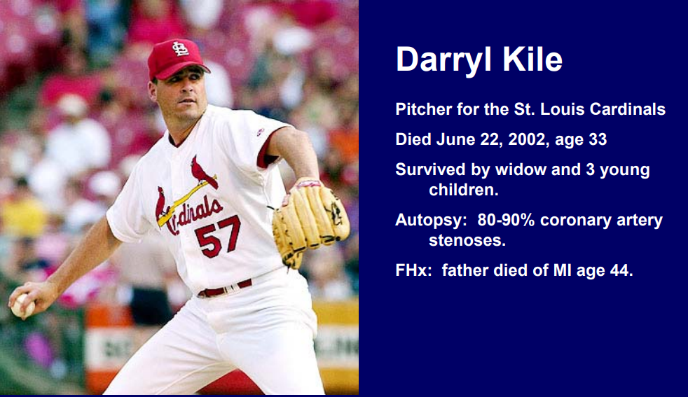

Slide 5
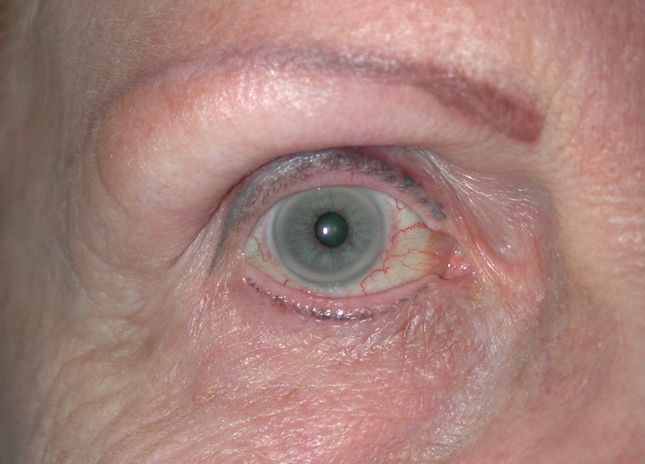

Slide 6
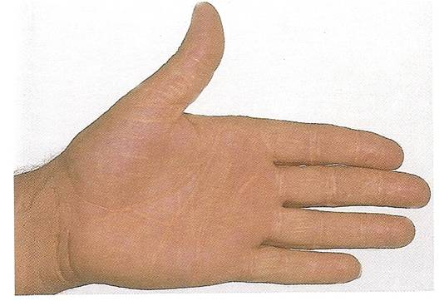

Slide 7
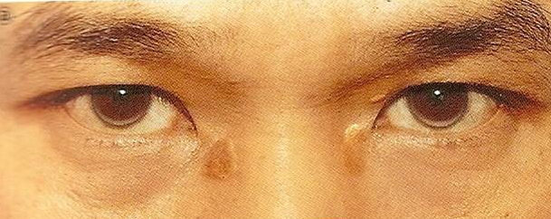

Slide 8
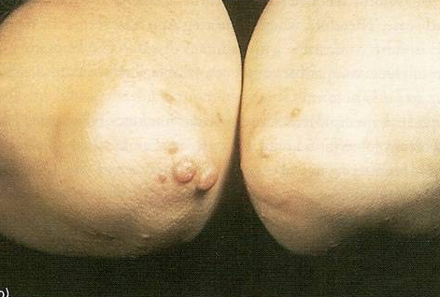

Slide 9
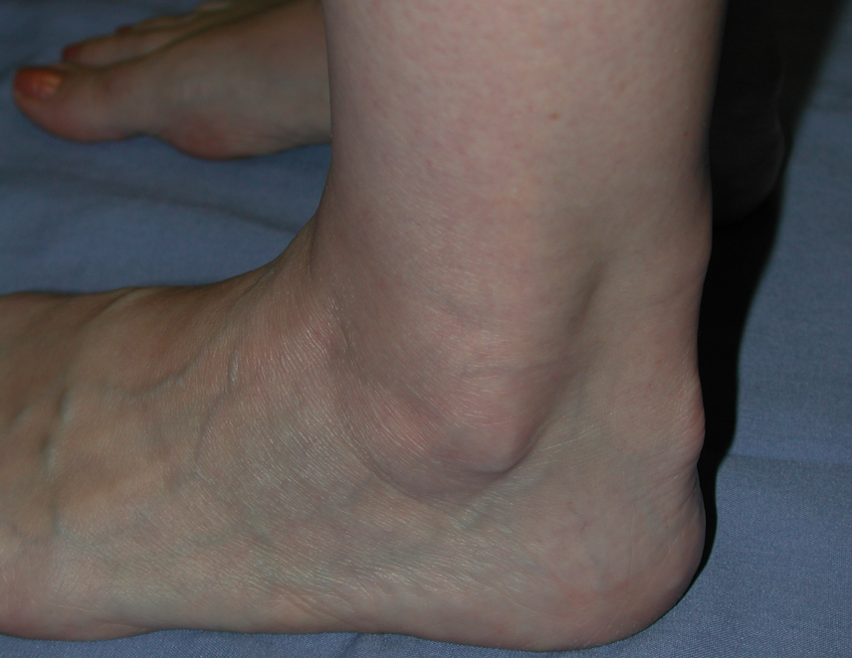

Slide 10
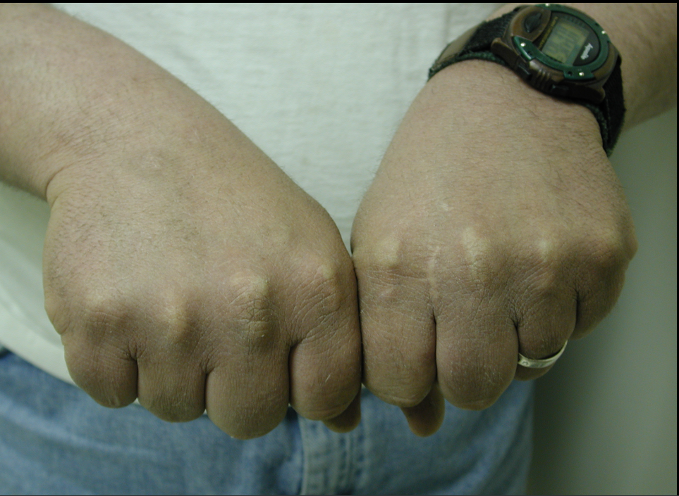

Slide 11

Familial Hypercholesterolaemia:
What goes wrong?
NORMAL
FH

Slide 12
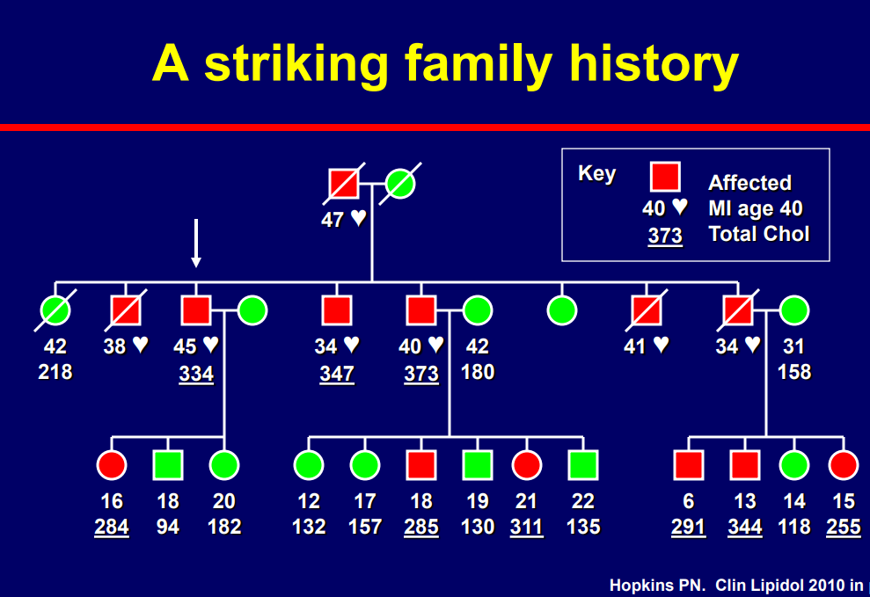

Slide 13
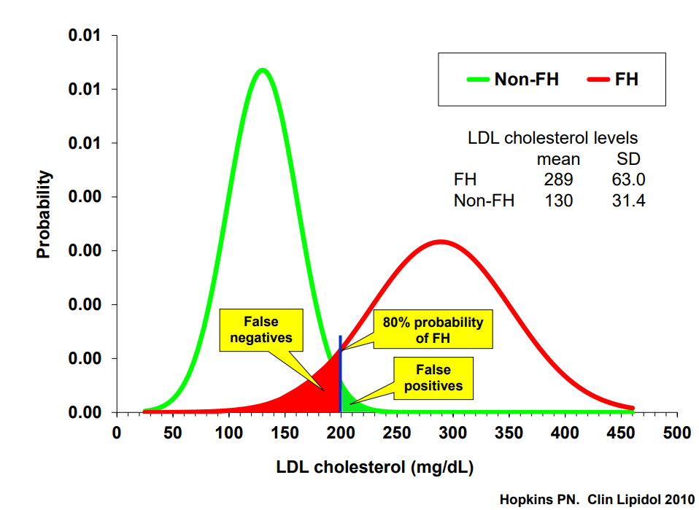

Slide 14
What are the various criteria for the diagnosis of FH?
Dutch Lipid Clinic Network diagnostic scoring
Simon Broome’s criteria
MedPed criteria for FH
NCEP ATPIII criteria

Slide 15
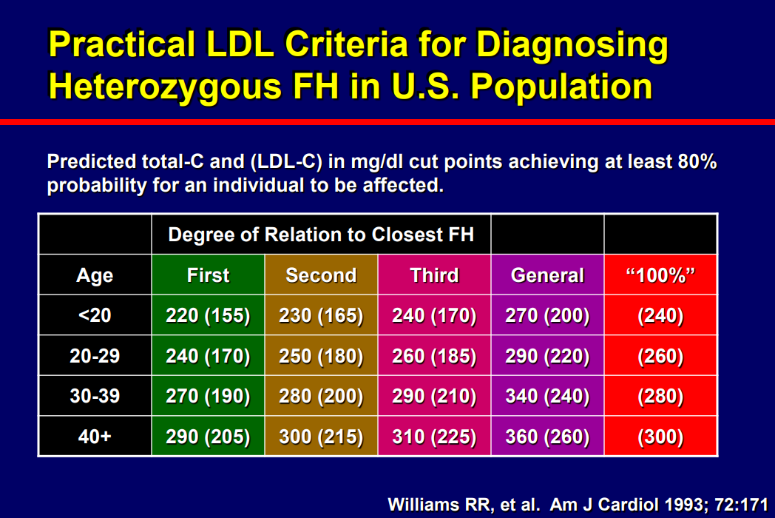

Slide 16
Typical Features of FH
Heterozygous FH
Homozygous FH
Cholesterol 7.0-14 mmol/L
One major genetic defect in LDL metabolism
Arcus cornealis and Achilles tendon xanthomas often present
CHD onset 30-60 years
Most respond to drugs, but individual response variable
Cholesterol 10-28 mmol/L
Two major genetic defects in LDL metabolism
Tendon and cutaneous xanthomas often before age 10 years
CHD onset in childhood
Poorly responsive to drugs; apheresis often indicated

Slide 17
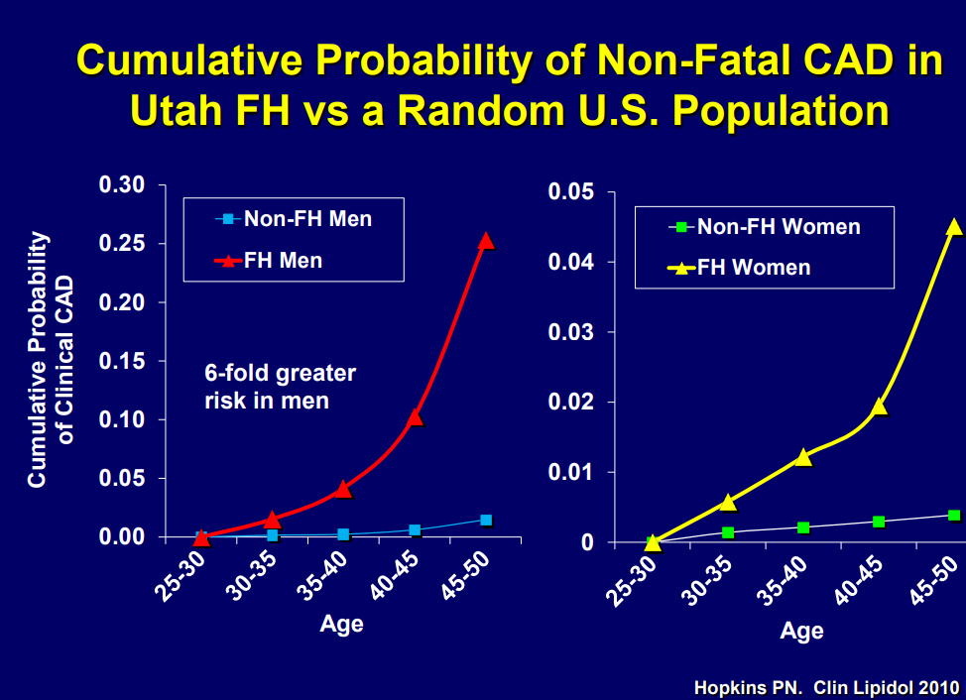

Slide 18
Adults: New Therapies
PCSK9 inhibitor: Evolocumab (Repatha), Alirocumab (Praluent)
Microsomal TG Transfer Protein Inhibitors –eg lomitapide (Juxtapid)
Antisense oligonucleotides (ASO) to inhibit Apolipoprotein B production –eg Mipomersen (Kynamro)
Above therapy should be considered as adjunctive treatments to diet and cholesterol lowering drugs in adults with homozygous FH

Slide 19


Slide 21
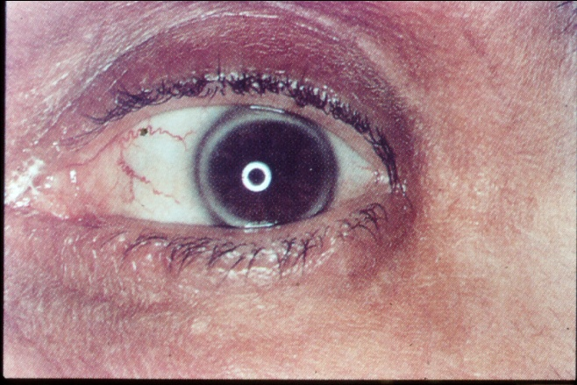

What is “FH”? What does it cause?
FH is
  Co-dominant mutation of genes affecting formation or function of the LDL-receptor
  This causes metabolic and clinical consequences including precocious cardiovascular disease (CVD)
Metabolic
  Increased LDL,
  Reduced clearance of remnants including LDL’s precursor, IDL.
  Increased Lp(a)?
  Reduced HDL?
Clinical
  Dominant: 50% of each generation. Risk 50:50
  Premature CHD, CVD and PVD
  Aortic stenosis
  Tendon xanthomas (11%) specific?
  Corneal arcus (27%) non-specific > 40y?
  Xanthelasmas (12%) nonspecific
  No signs highly sensitive
  FH IS NOT JUST HIGH CHOLESTEROL IN A PATIENT AND THEIR RELATIVE(S)

Slide 22
Familial Hypercholesterolaemia
FH accelerates atherosclerotic cardiovascular disease, especially coronary heart disease
Clinical manifestations often occurring after one to four decades of life
There are probably more than 20 million people with FH worldwide

Slide 23
